Slide 1
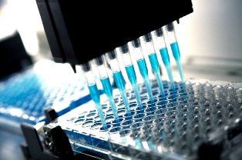
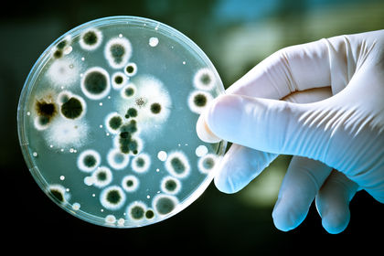
Biotechnology
Understanding the Application

Slide 2
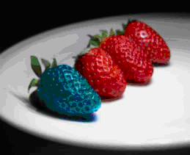
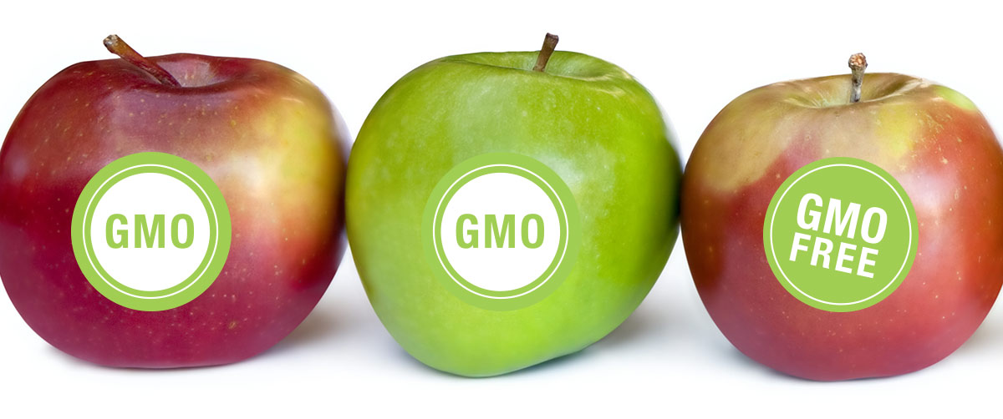
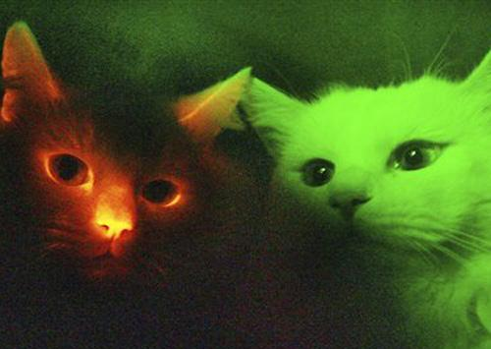
Genetic Engineering
Genetic engineering refers to any process in which man alters an organism’s DNA
Examples: cloning, genetically modified organisms (GMO), etc.
This unit, we will be exploring different types of genetic engineering and the ethical issues that arise within the field!

Slide 3
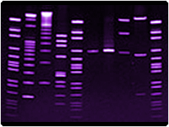
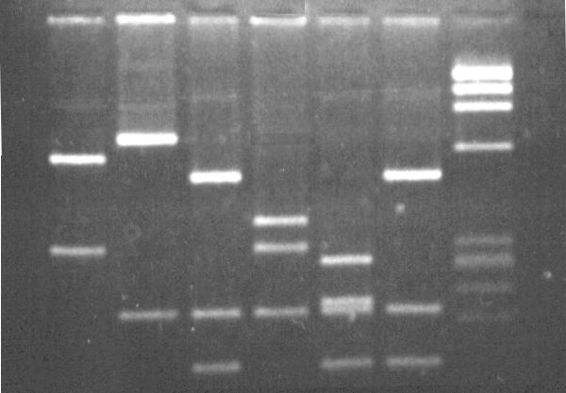
Gel electrophoresis

Slide 4
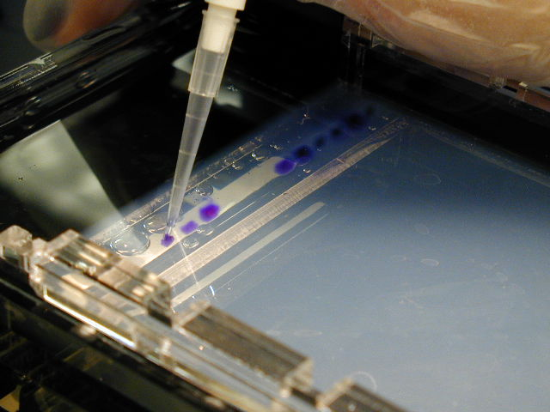
Gel electrophoresis
Gel electrophoresis is the process of separating molecules (DNA, RNA, proteins) based on size
This process of comparing DNA is used in a number of things, including identifying individuals through fingerprinting, parental ID, and evolutionary relationships!

Slide 5
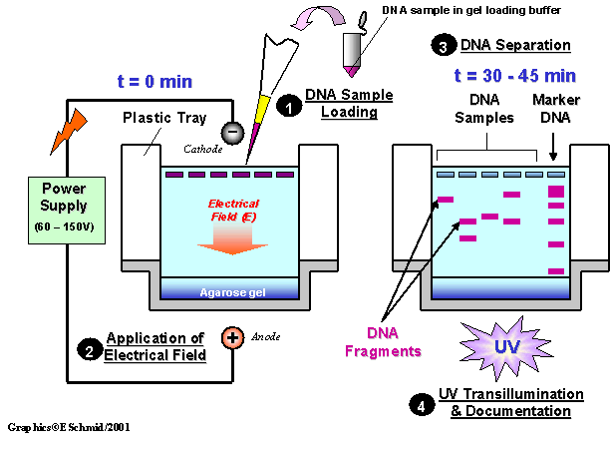
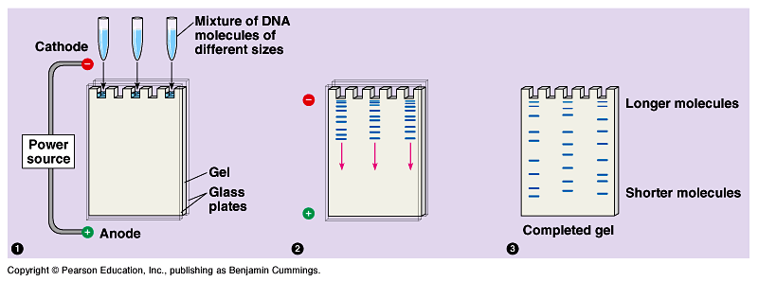
Steps in Gel Electrophoresis
DNA samples are cut into different sized fragments using restriction enzymes
Fragments are run on gels through an electric current. Longer fragments move slowly (not as far), while smaller pieces will move faster (farther)
These movements will create bands on the gel that can be read under UV light or through staining
The different bands can be compared to other DNA segments for genetic similarities

Slide 6
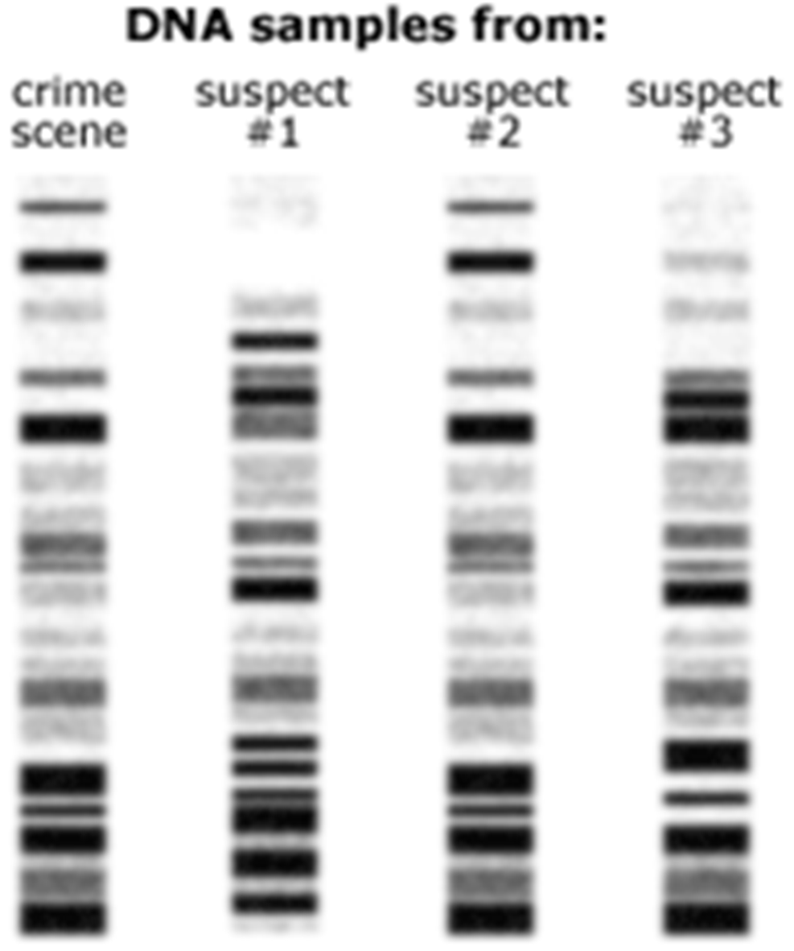
Using Gels: Identifying Individuals
DNA fingerprints are different for every person (except identical twins)
Can be used to identify suspects…which suspect’s gel matches the crime scene?

Slide 7
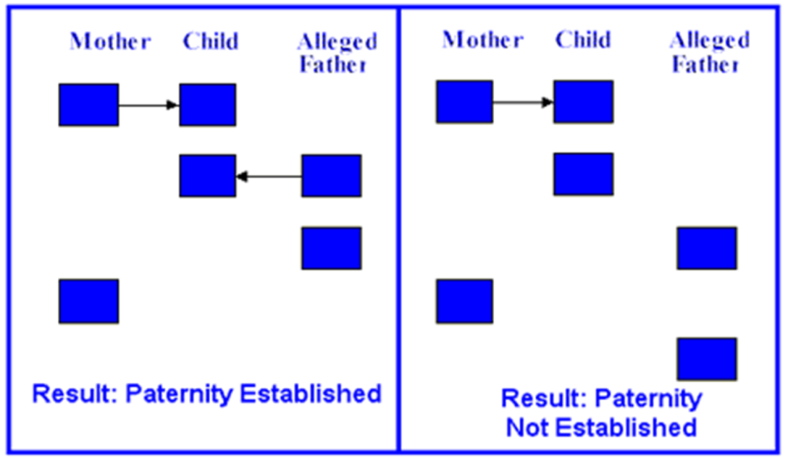
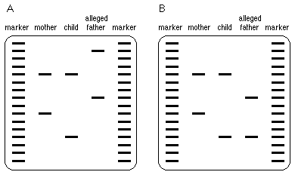
Using Gels: Paternity
Parental gels can help determine the father
Gels are read with half the bands coming from mom, and half from dad
In this gel, is the father shown in A or B?

Slide 8
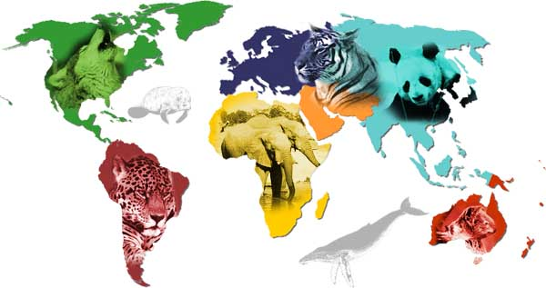
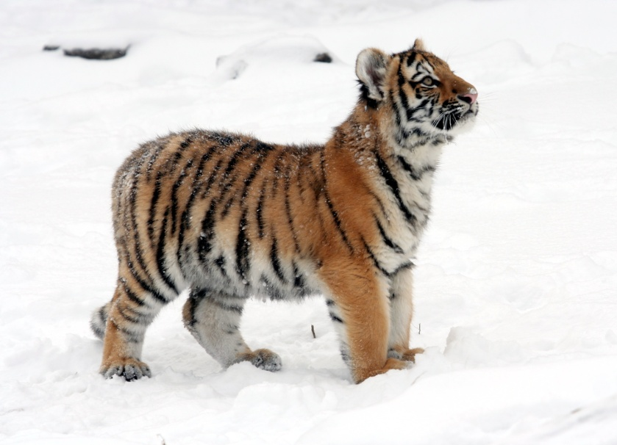
Using Gels: Endangered Species
Species can be identified using gel electrophoresis- used in identifying and cataloguing species

Slide 9
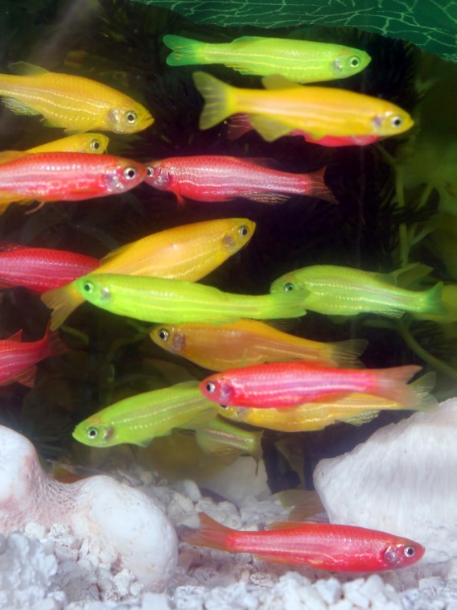
Transgenic Organisms

Slide 10
What is a Transgenic Organism?
A transgenic organism is any organism that has a gene from another organism within it
Inserting a foreign piece of DNA into a cell
Transgenic organisms come about when humans would like the traits of one organism to be present in another!
Transgenic organisms are commonly used in agriculture and industries like pharmaceutical companies

Slide 11
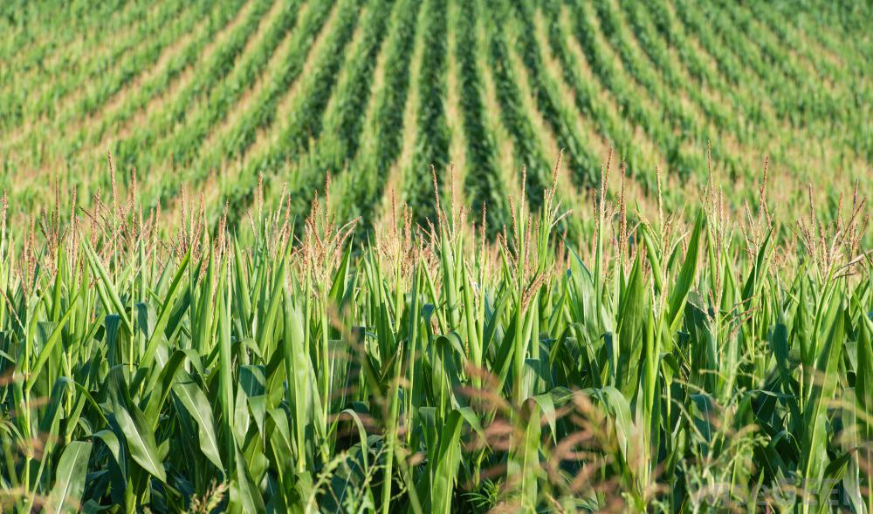
Transgenic Organisms: Agriculture
Sometimes, transgenic organisms are grown in agriculture in order to help keep crops healthy, resist pests, produce higher yield and last longer.
Examples include:
BT Corn-pesticide resistant corn that incorporates a gene poisonous to insects: this prevents insects from eating it
Frost resistant strawberries-a gene inserted from arctic fish allows strawberries to grow in colder seasons
Sometimes, they are grown in agriculture to appeal to human tastes
Examples: Grapples (part apple, part grape)

Slide 12
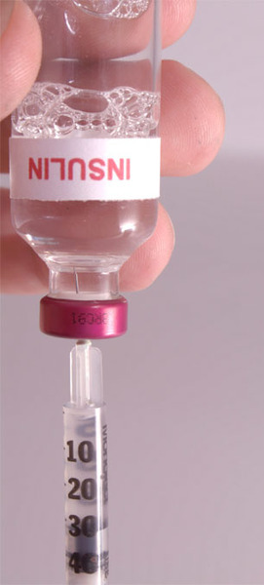
Transgenic organisms: Industry
Transgenic organisms have allowed for the production of things previously unavailable to us
Example: The production of Human Insulin
Insulin diabetics must inject insulin because their body does not produce or use it normally
Thanks to genetic engineering, scientists have found a way to create synthetic insulin produced by bacteria or yeast
Things like this are done through a process called bacterial transformation

Slide 13
Steps of Bacterial Transformation
First, you must isolate the gene of interest
Insertion of foreign DNA gene into bacterial plasmid. Done using restriction enzymes and DNA ligase.
A plasmid is a genetic structure in a cell that can be separated from the chromosomal DNA and replicate independently; typically used in lab manipulation of genes
Getting bacteria to take in the plasmid; Recombinant DNA is inserted into the bacteria.
Selecting the successfully transformed bacteria
Producing the product
The bacteria has now been modified to produce the product based on the genes that were selected and inserted (ex. Insulin in bacteria)
https://www.youtube.com/watch?v=TpmNfv1jKuA

Slide 14
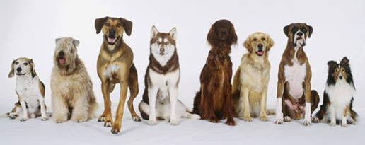
Selective Breeding
When man chooses specific organisms to breed to get desired offspring
Ex. Dogs

Slide 15
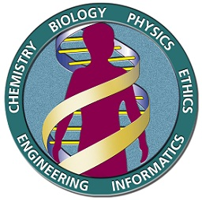
The Human Genome Project

Slide 16
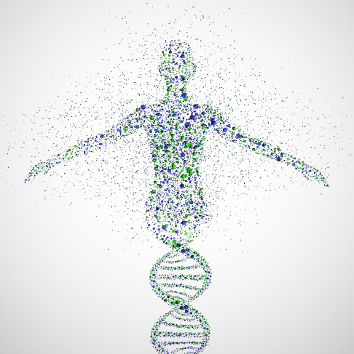
Human Genome Project
Started in 1990, the Human Genome Project was started with the goal of determining the sequence of chemical base pairs that make up human DNA
Scientists wanted to identify and map all the genes of the human genome!

Slide 17
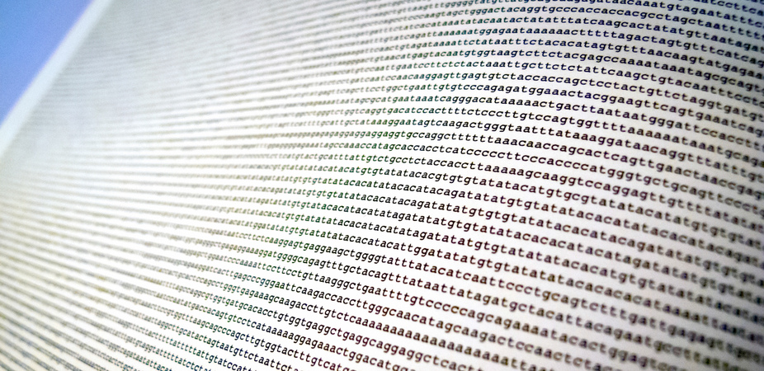
Why The human genome project?
The Human Genome Project was established with the hope that knowing the human genome would allow them not only to identify genes that cause genetic conditions (diabetes, heart disease, cancer, etc.), but also treat those diseases!

Slide 18
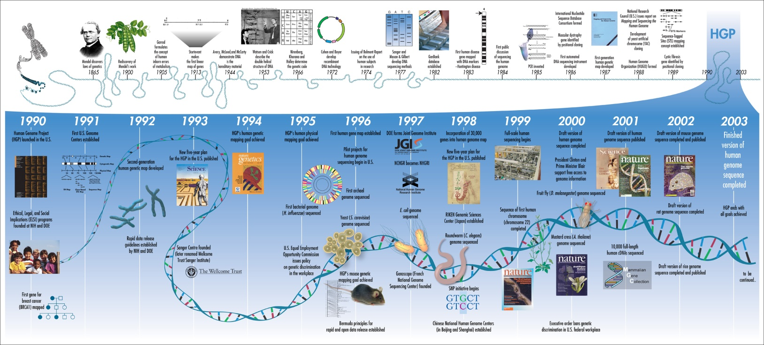
The human genome project
The Human Genome Project was successfully completed in April of 2003!
For the first time, scientists were able to read the genetic blueprint of a human being!
Just as scientists hoped, this project has been useful in determining carrying genes and developing gene therapy

Slide 19
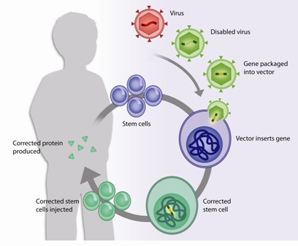
Gene therapy
Gene therapy is a method of using genes to treat or prevent disease
Nucleic acids polymers inserted into cells as a drug are used to express proteins or interfere with expression
Remember-DNA codes for proteins that determine traits!
Uses include:
Immunodeficiency-An immunodeficiency disease in one in which disorders prevent the body from fighting infections and diseases the way it should
Cystic Fibrosis
We will discuss ethical implications a bit later!

Slide 20
Ethical issues in genomics and biotechnology

Slide 21
Genetically modified Organisms
Genetically modified organisms, or GMOs, are often a big debate-especially since many are consumed by us!
Examples: disease resistant plants
They are produced for numerous reasons in order to benefit consumers, including increasing crop production, lowering prices
There is debate, however, on whether this is always safe for human consumption since the modifications do not occur naturally
Allergies, gene transfer to cells of the body, etc.
What do you think?

Slide 22
The debate over biotechnology
When talking about this topic, the largest issue is always the ethical implications of such methods
What do you think?
Should science improve humans?
Should science improve other organisms?
What consequences might there be to this technology?
Let’s look at some examples of debated biotechnology techniques…

Slide 23
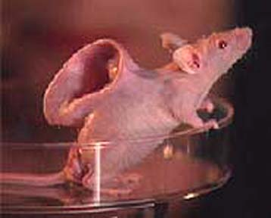
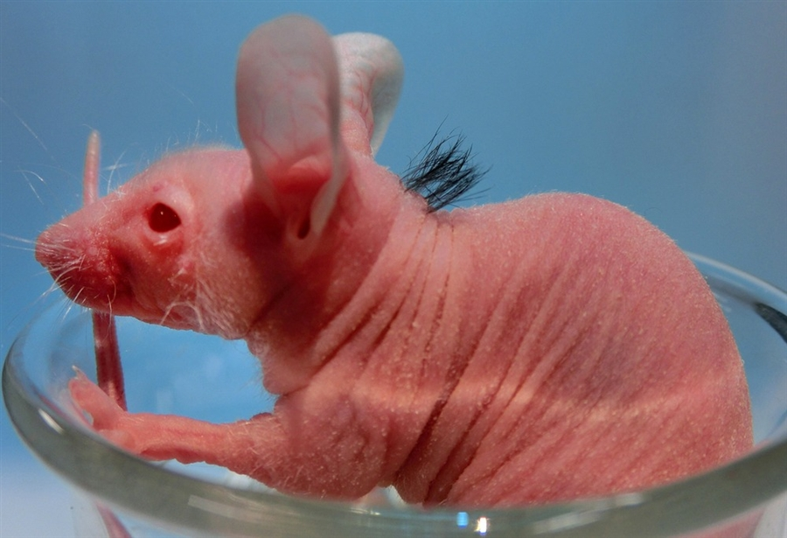
Transgenic Organisms
Example: Transgenic Mice (hair gene removed)
Used to help burn patients and others by making human facial parts (ears, nose lips, etc.)
https://www.youtube.com/watch?v=kefoIXnLAN0

Slide 24
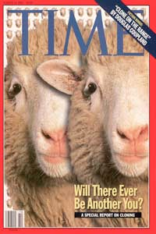
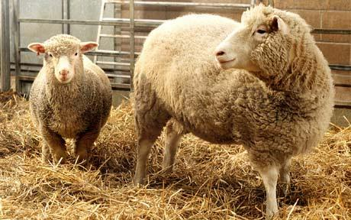
cloning
Making an identical copy of an organism
Done through 1. Taking unfertilized egg of female and removing nucleus, 2. Retrieving nucleus of somatic (body) cell of individual you would like to clone, 3. Inserting the somatic nucleus into egg cell and 4. Providing growth factors needed
First animal to be cloned was Dolly the sheep in 1996

Slide 25
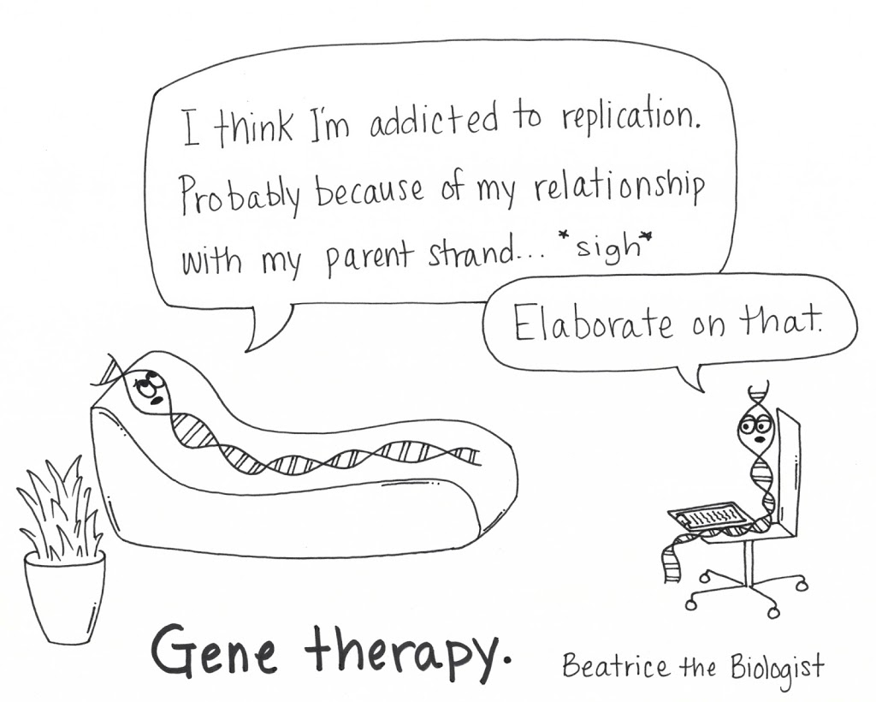
Gene Therapy
Recall that gene therapy uses the alteration of a person’s genes to treat genetic conditions
Ethical issues surrounding this include:
Who decides which traits are normal/faulty?
Will this only be available to wealthy individuals?
Should it be used to enhance other traits, like height, intelligence, or athletic ability?

Slide 26
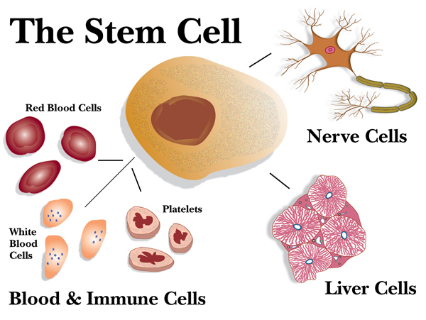
Stem Cells
Stem cells are undifferentiated cells that can become any different type of cells
Recall that differentiation takes place as a zygote develops-undifferentiated cells become complex system of tissues and cell types
Embryonic Stem Cells- Can become all cell types in the human body
Adult Stem Cells- Thought to be limited to differentiating into only those cell types of their tissue of origin (brain, heart, blood, etc.)

Slide 27
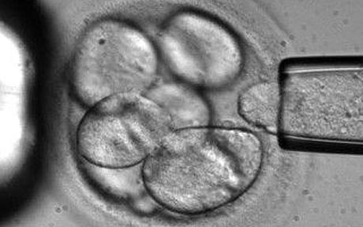
Stem cell research
Stem cells are used in research with the potential to treat diseases and aid in research
However, ethical issues cause debate since stem cells are derived from zygotes- In order to use them, human embryos must be destroyed
Debate is still ongoing, but new research about stimulating a patients cells to behave like stem cells may open new possibilities

