Slide 1
DNA/RNA
Transcription and Translation

Slide 2
Review…
DNA is responsible for controlling the production of proteins in the cell, which is essential to life
  DNA→RNA→Proteins
Chromosomes contain several thousand genes, each with the directions to make one protein
Do you remember the organelle where proteins are produced?

Slide 3
Where are Proteins Produced?
Ribosomes!
Ribosomes are where proteins are made
Ribosomes are found in two places:
  Free floating in the cytoplasm
  Attached to Endoplasmic Reticulum (Rough ER)
So…how does information needed to build the protein get delivered from the DNA to the ribosomes???
  -With the help of RNA in a process called protein synthesis!

Slide 4
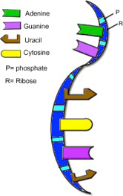
What is RNA?
RNA stands for ribonucleic acid
One subunit of RNA is a nucleotide (just like DNA!)
  1 - 5 carbon sugar (it’s ribose in RNA)
  1 - phosphate group
  1 – nitrogenous (N) base
Three types of RNA
  mRNA, rRNA, tRNA
  First, we will look at mRNA!

Slide 5
A Closer Look: mRNA
Looking at the mRNA to the right, how is it different visually from DNA?
  It is single stranded
  It is shorter and able to leave the nucleus
  The sugar is ribose
  There is a different base
    Uracil (U) takes the place of Thymine (T)

Slide 6
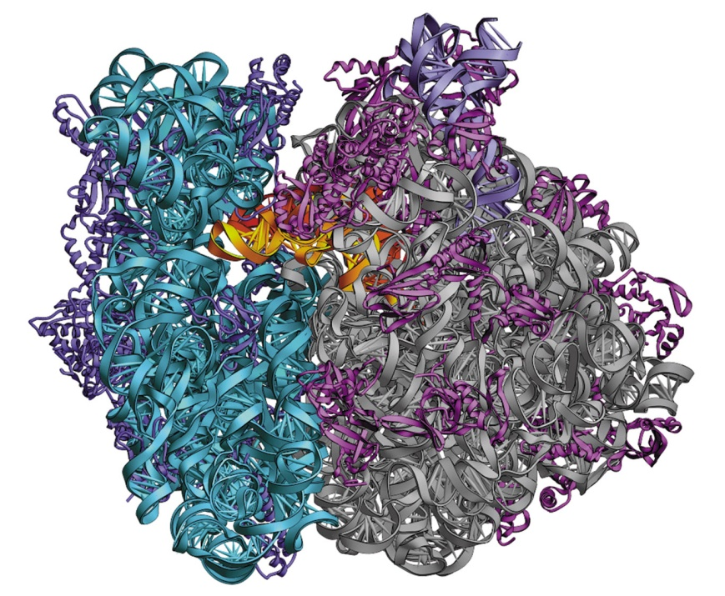
About mRNA
The job of mRNA is to take the directions for one gene and transport it to a ribosome in the cytoplasm where it is translated.
  This is so the cell can begin assembling amino acids, the building blocks of proteins
  Like it’s name, it is sending a message on how to do the job
  This is part of a process called protein synthesis
A ribosome up close!!

Slide 7
Protein Synthesis
Protein synthesis is a two stages process
  Transcription and Translation
In this process, a messenger molecule (mRNA) carries instructions from DNA to ribosomes
  DNA cannot leave the nucleus!
  mRNA can!
mRNA makes it possible for proteins to be assembled by ribosomes outside of the nucleus

Slide 8
Protein Synthesis
Transcription

Slide 9
Protein Synthesis: Transcription
Transcription happens when DNA is turned into mRNA
This happens when proteins need to be made in the cytoplasm!
Since DNA cannot leave the nucleus, it is transcribed into RNA (DNA→RNA)
  Transcribe: to copy (copy in the same nucleic acid language, but only copy what is needed)

Slide 10
Protein Synthesis: Transcription
How does it happen?
  After an enzyme targets the portion of the DNA that should be copied (initiation), the sections of DNA (genes) will temporarily unwind to allow mRNA to transcribe (copy). This will continue until an enzyme signals “the end”
  mRNA leaves the nucleus, travels into the cytoplasm and attaches to a ribosome
  The “message” from DNA can now be translated to make a protein

Slide 11
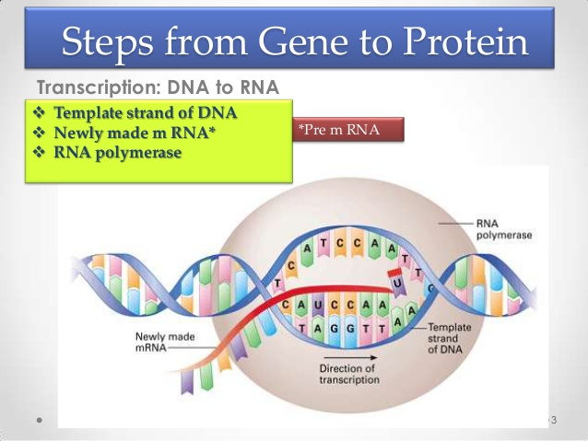
Transcription

Slide 12
Practicing Transcription
Transcribing DNA to mRNA is very easy if you remember these complementary pairs!
  C (in RNA) will attach to a G (in DNA)
  G (in RNA) will attach to a C (in DNA)
  A (in RNA) will attach to a T (in DNA)
  U (in RNA) will attach to a A (in DNA)
Try it!
  A piece of DNA reads: T A G C A T T C C G A U
  transcribe to mRNA:___________________________

Slide 13
Practicing Transcription
If 1 side of DNA reads:
A A G C G T A T C C C G
Then mRNA reads:
____________________________

Slide 14
Bellringer-3/27/15
Describe the steps taken during transcription.
Transcribe the following to mRNA:
  AAT CGA TAG CCG ATA

Slide 15
Protein Synthesis
Translation

Slide 16
TRANSLATION
Translation: the process in which mRNA is used as a blueprint to form chains of amino acids (RNA→Protein)
  Amino acids linked together form a protein
  Translate: To change a sentence from one language (nucleic acid) to another (amino acid)
Every 3 letters on an mRNA chain = codon
  Each codon (3 DNA letters) = 1 amino acid

Slide 17
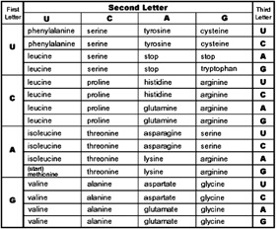
Reading a Codon Chart
Given the mRNA, we can read a codon chart to translated into the amino acid it codes for
Remember, 1 word in nucleic acid language is a codon (three nucleotides)

Slide 18
Practice: Reading a Codon Chart
What amino acid is coded for?
  A U G
  G U C
  G C C
  C G A
  U A A

Slide 19

Protein Synthesis: Translation
Occurs in a ribosome in ALL cells
This process uses all three forms of RNA (mRNA, rRNA, and tRNA)
DNA is not directly used!
mRNA
rRNA
AA (amino acid)
tRNA
anticodon

Slide 20
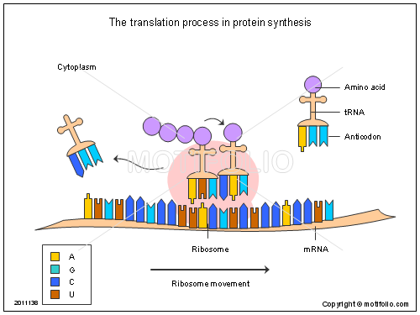
Steps of Translation
1.The mRNA leaves the nucleus and lands on a ribosome (rRNA)

Slide 21
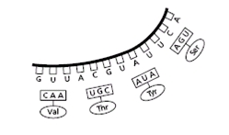
Steps of Translation
2. tRNA (with the correct anticodon) lands on the ribosome opposite a codon on the mRNA

Slide 22
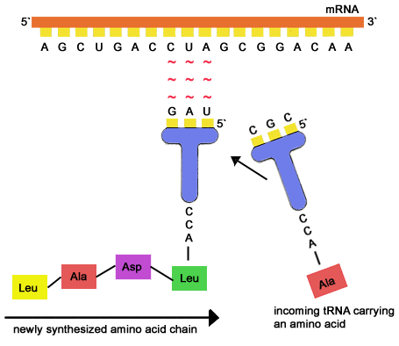
tRNA: A Closer Look
Notice the tRNA is carrying the amino acid leucine, coded for by the sequence “CUA” (check your codon chart”)
The tRNA knows how to match using bases! In RNA, G→C and A→U:
So…mRNA codon reads “CUA,” so the tRNA anticodon will be “GAU”

Slide 23
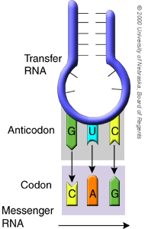
tRNA: A Closer Look
Amino acid
anticodon

Slide 24
Steps of Translation
3. The tRNA leaves the ribosome, but the amino acid that it coded for stays on the ribosome to wait for next codon to be read

Slide 25
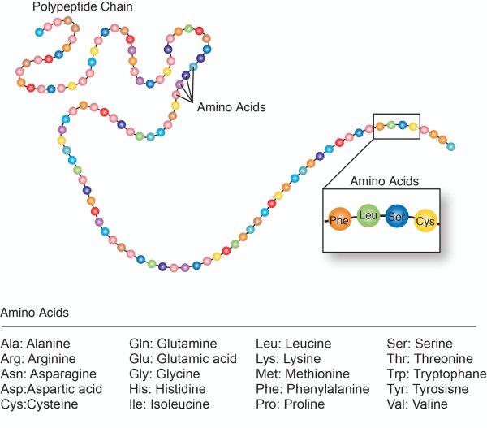
Steps of Translation
4. The ribosome moves to the next codon bringing in another amino acid to the growing protein chain.

Slide 26
An Amino Acid Chain
The amino acid chain will ALWAYS begin with the “START codon”- AUG
The tRNA will continue to add amino acids until it reaches a “STOP codon” (UAA, UAG, UGA)
When it reaches a stop codon, then a complete protein has been built! The protein unattaches from the ribosome.

Slide 27
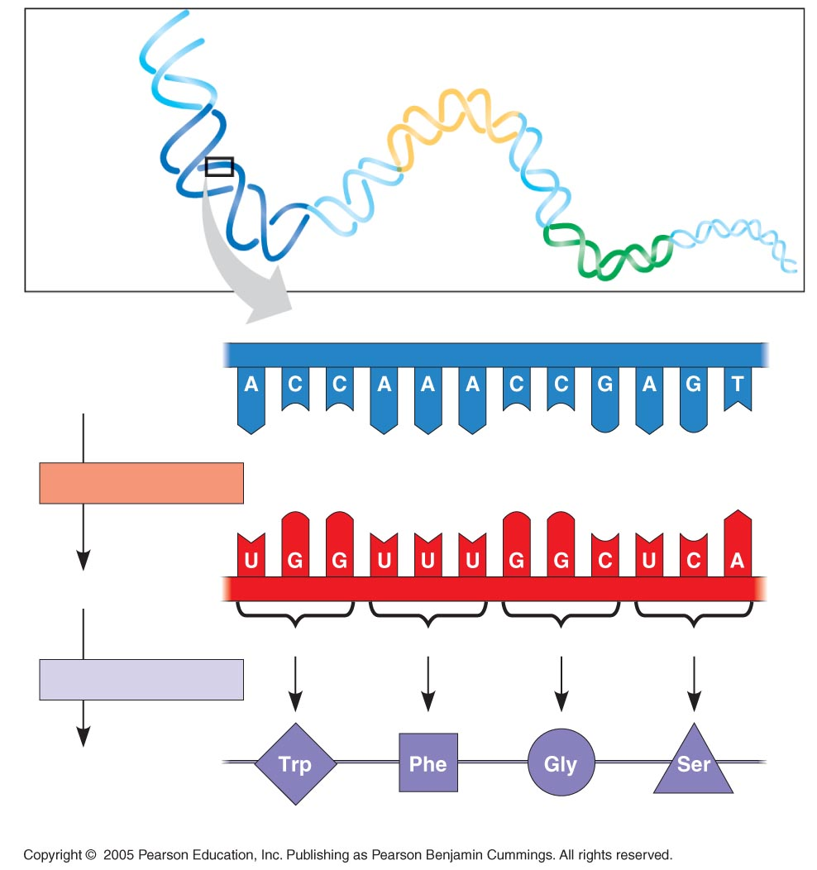
DNA
molecule
DNA strand
(template)
3′
5′
TRANSCRIPTION
mRNA
5′
3′
Codon
TRANSLATION
Protein
Amino acid

Slide 28
Let’s practice…….
Given the strand of DNA below, what would it’s complementary DNA strand read?
ATC
Now, transcribe the DNA to mRNA
What amino acid does the codon code for? (use codon chart)
What would the anticodon on the tRNA read?

Slide 29
Try Again!
Given the strand of DNA below, what would it’s complementary DNA strand read?
TGA
Now, transcribe the DNA to mRNA
What amino acid does the codon code for? (use codon chart)
What would the anticodon on the tRNA read?

Slide 30
Bellringer-3/30/15
Given the strand of DNA below, what would it’s complementary DNA strand read?
ATC GCT AGG TAA
Now, transcribe the DNA to mRNA
What amino acid does the codon code for during translation? (use codon chart)
What would the anticodon on the tRNA read?

Slide 31
Bellringer-3/31/15
Describe the steps to protein synthesis in detail. Be sure to address the information below in your explanation:
  Where does transcription occur?
  What is the purpose of mRNA?
  Where does translation occur?
  What does a tRNA molecule do?
  How does the process end?

Slide 32
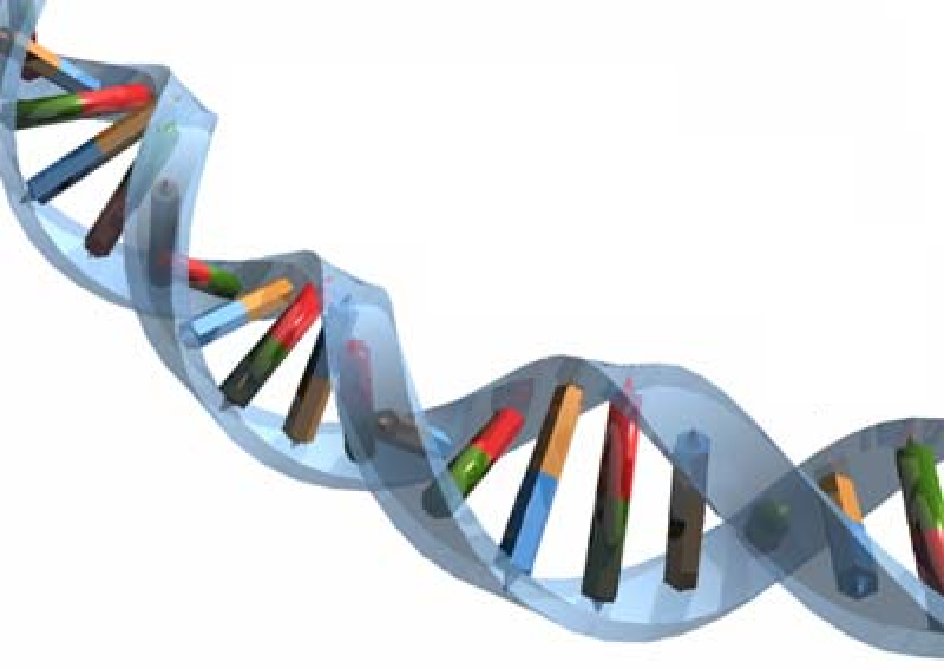
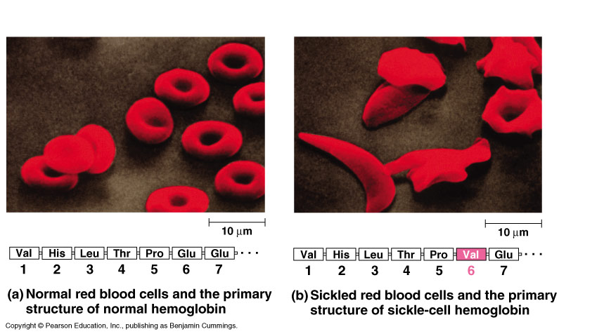
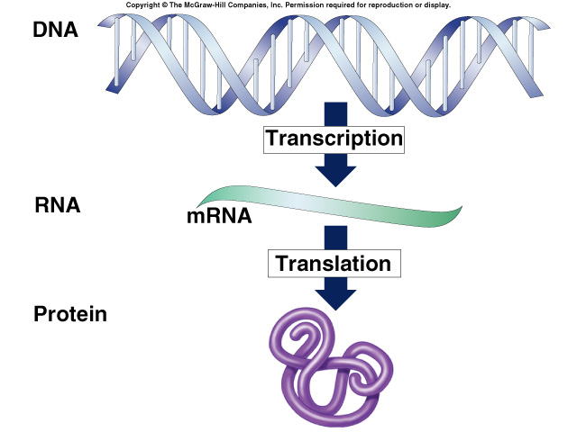
Mutations
Changes to DNA

Slide 33
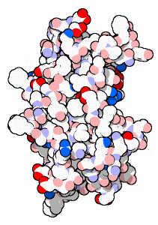

Mutations
Changes to DNA are called mutations
  change the DNA
  changes the mRNA
  may change protein
  may change trait
DNA
TACGCACATTTACGTACG
mRNA
AUGCGUGUAAAUGCAUGC
protein
aa
aa
aa
aa
aa
aa
aa
trait

Slide 34
Types of mutations
Changes to the letters
(A,C,T,G bases) in the DNA
  point mutation
    change to ONE letter (base) in the DNA
    may (or may not) cause change to protein
  frameshift mutation
    addition of a new letter (base) in the DNA sequence
    deletion of a letter (base) in the DNA
    both of these shift the DNA so it changes how the codons are read
    big changes to protein!

Slide 35
Point Mutations
One base change
  can change the meaning of the whole protein
THEFATCATANDTHEREDRATRAN
Does this change
the sentence?
A LITTLE!
THEFATCARANDTHEREDRATRAN
OR
THEFATCATENDTHEREDRATRAN

Slide 36
Point Mutations
Missense mutation = changes amino acid
AUGCGUGUAUACGCAUGCGAGUGA
Met Arg Val Tyr Ala Cys Glu Stop
Does
this change
the protein?
DEPENDS…
AUGCGUGUAUACGUAUGCGAGUGA
Met Arg Val Tyr Val Cys Glu Stop

Slide 37
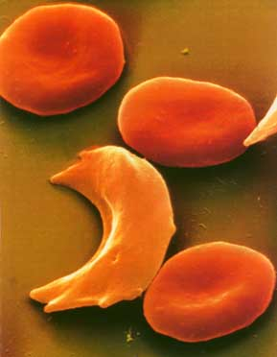
Sickle cell anemia
Hemoglobin protein in red blood cells
  strikes 1 out of 400 African Americans
  limits activity, painful & may die young
Normal
round cells
Misshapen
sickle cells
Only 1 out of
146 amino acids

Slide 38
Point Mutations
Silent mutation = no change to protein
AUGCGUGUAUACGCAUGCGAGUGA
Met Arg Val Tyr Ala Cys Glu Stop
Does this change
the protein?
Why not?
The code has
repeats in it!
AUGCGUGUAUACGCUUGCGAGUGA
Met Arg Val Tyr Ala Cys Glu Stop

Slide 39
Point Mutations
Nonsense mutation = change to STOP
AUGCGUGUAUACGCAUGCGAGUGA
Met Arg Val Tyr Ala Cys Glu Stop
Really destroyed
that protein!
AUGCGUGUAUAAGCAUGCGAGUGA
Met Arg Val Stop

Slide 40
Frameshift Mutations
Add or delete one or more bases
  changes the meaning of the whole protein
THEFATCATANDTHEREDRATRAN
Does this change
the sentence?
A LOT!
Delete one!
Add one!
THEFATCANTANDTHEREDRATRAN
OR
THEFATCAANDTHEREDRATRAN

Slide 41
Frameshift Mutations
Addition = add one or more bases
AUGCGUGUAUACGCAUGCGAGUGA
Met Arg Val Tyr Ala Cys Glu Stop
Does this change
the protein?
A LOT!
AUGCGUGUAUACGUCAUGCGAGUGA
Met Arg Val Tyr Val Met Arg Val

Slide 42
Frameshift Mutations
Deletion = lose one or more bases
AUGCGUGUAUACGCAUGCGAGUGA
Met Arg Val Tyr Ala Cys Glu Stop
Does this change
the protein?
A LOT!
AUGCGUGUAUACGAUGCGAGUGA
Met Arg Val Tyr Asp Ala Ser

Slide 43
Bellringer-4/1/15
Name and describe the two main types of mutations we talked about yesterday.
Do mutations always cause a change in amino acid? Why or why not?

