Slide 1
Meiosis
Sexual Reproduction and Genetics

Slide 2
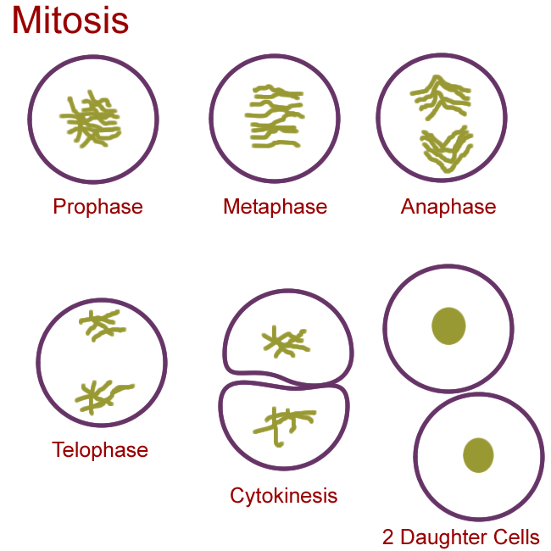
Review of Mitosis

Slide 3
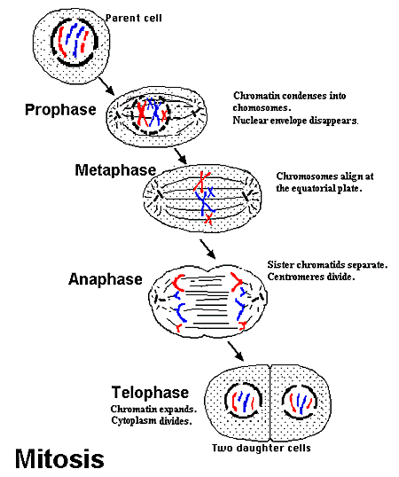
Recall Mitosis…
Mitosis is a form of asexual reproduction
This means that it only requires 1 organism (ex. Skin cells dividing)
For growth and repair in somatic (body) cells!
Results in 2 cells identical to the original (parent) cell

Slide 4
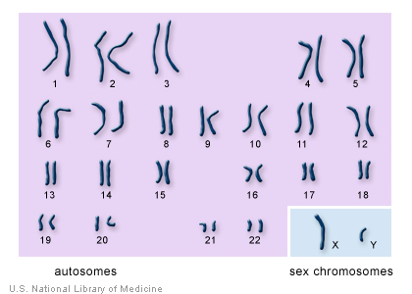
Mitosis…A Closer Look
Recall that DNA is condensed into chromosomes
Humans have a total of 46 chromosomes per cell (23 pairs)
22 of these pairs are autosomes present in all; one pair is a sex chromosome (XX vs. XY)
When mitosis occurs, each new cell will have 46 chromosomes, just like the original

Slide 5
Mitosis…A Closer Look
The cells produced in Mitosis are said to be diploid→ diploid cells contain two complete sets (2n) of chromosomes

Slide 6
Mitosis Review
Asexual Reproduction
Growth and repair of somatic (body) cells
One diploid (2n) cell (46 chromosomes) divides once
Produces two identical cells (46 chromosomes each)

Slide 7
Meiosis

Slide 8
Meiosis
Meiosis is a form of sexual reproduction
This means it takes 2 organisms to make a new organism
Results in 4 daughter cells that are not identical to the parent cell
These daughter cells are called gametes (sperm and egg cells) that combine to make a new organism

Slide 9
So what happens?
There are two phases in meiosis
In Meiosis I, the cell divides
In Meiosis II, the cells divide again, creating 4 cells

Slide 10
Meiosis…A Closer Look
The cells produced in Meiosis are said to be haploid→ haploid cells contain half the number of chromosomes as diploid (n)
When meiosis occurs, each new cell will have 23 chromosomes, half of the original

Slide 11
Why Half?
The cells contain half because they combine to make a new organism
The haploid gametes (n, the sperm and the egg) fuse during fertilization to make a diploid cell (2n)
This new diploid cell is called a zygote, and it will grow into a new organism

Slide 12
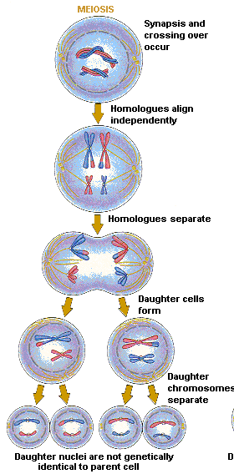
Meiosis Review
Sexual Reproduction
A diploid (2n) cell divides twice
Produces four different haploid gametes (n) with half the original chromosomes (23 each)
Gametes are sperm and egg cells
Two gametes combine to form a diploid zygote (2n) with the original number of chromosomes (46)

Slide 13
Mitosis vs. Meiosis
 | Mitosis | Meiosis
Type of Reproduction | Asexual | Sexual
Purpose | Growth and Repair | Create Gametes (which fuse to make a new organism)
Number of Divisions | 1 | 2
Number of Cells Produced | 2 identical diploid (2n) cells | 4 unique haploid (n) cells
Chromosome Number | Remains the same (46 in humans) | Half of the original (23 in humans)

Slide 14
Genetic Diversity

Slide 15
Why is Meiosis Important?
Meiosis (sexual reproduction) leads to greater genetic diversity
Traits being inherited independently of one another allows organisms to be genetically different
Think about it: Do you and your parents/siblings/family look exactly alike?

Slide 16
Genetic Diversity is Important Because…
Groups with varying genetics have a greater chance to survive and flourish
Ex. Some individuals inherit traits that help them survive, like being resistant to a disease
Genetic diversity reduces the incidence of unfavorable traits
Ex. When closely related organisms interbreed, genetic flaws become more common due to lack of diversity (inbreeding)

Slide 17
Sources of Genetic Variation
Random Fertilization
Independent Assortment of Chromosomes
Crossing Over of Homologous Chromosomes
Mutations

Slide 18
Sources of Genetic Variation
The process of fertilization and the random assortment of chromosomes during meiosis make genetic variation possible
Remember, sexual reproduction produces the greatest amount of variation-this is essential to the survival of populations!

Slide 19
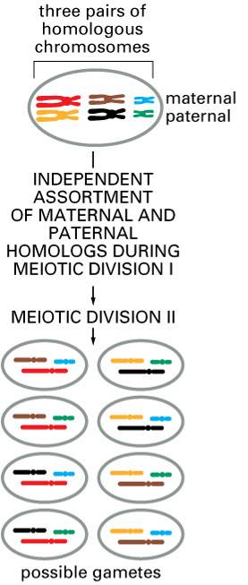
Independent Assortment
Independent assortment produces 2^{n} distinct gametes, where n = the number of unique chromosomes.
In humans, n = 23 and 2²³ = 6,000,0000.
That’s a lot of diversity by this mechanism alone.

Slide 20
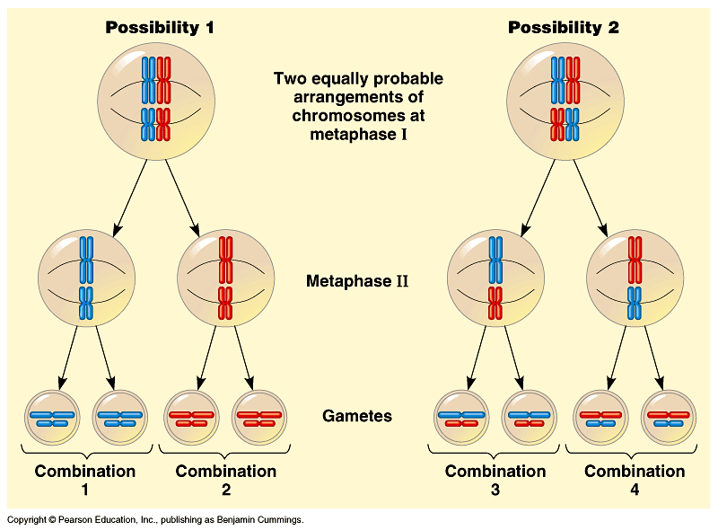

Slide 21
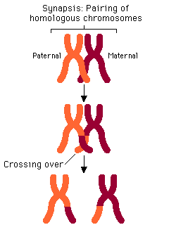
Sexual Reproduction: Sources of Genetic Variation
Crossing Over
During Meiosis, the homologous chromosomes (a set of 1 maternal and 1 paternal) undergo a process called crossing over
This is the exchange of genetic material between chromosomes
Results in greater diversity

Slide 22
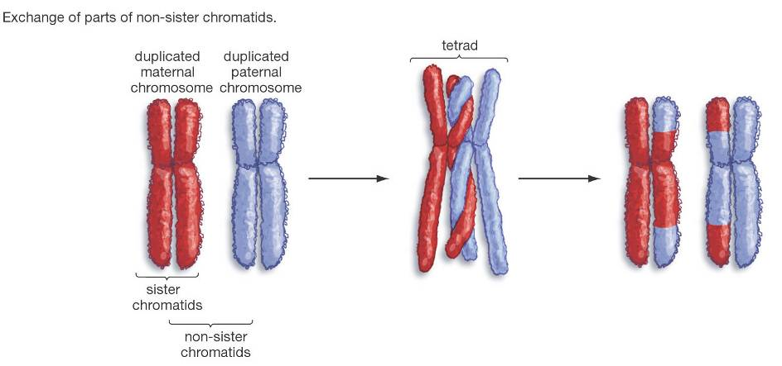
Crossing-Over
Crossing-over multiplies the already huge number of different gamete types produced by independent assortment.

Slide 23
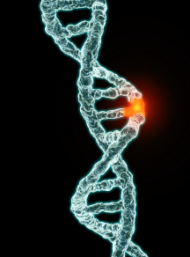
Sources of Genetic Variation
Gene Mutation
Mutations can cause variations in genes by introducing new traits into a population
Mutations that can be passed down are those in gametes (sperm and egg cells)
Other mutations, such as tobacco smoke altering lung cells, cannot be passed down

Slide 24
Sources of Genetic Variation
Nondisjunction
Nondisjunction is the failure of homologous chromosomes or sister chromatids to separate correctly during cell division

Slide 25
Meiosis – division error
Chromosome pair

Slide 26
Meiosis error - fertilization
Should the gamete with the chromosome pair be fertilized then the offspring will not be ‘normal’.
In humans this often occurs with the 21st pair – producing a child with Downs Syndrome

Slide 27
21 trisomy – Downs Syndrome
Can you see the extra 21st chromosome?
Is this person male or female?

Slide 28
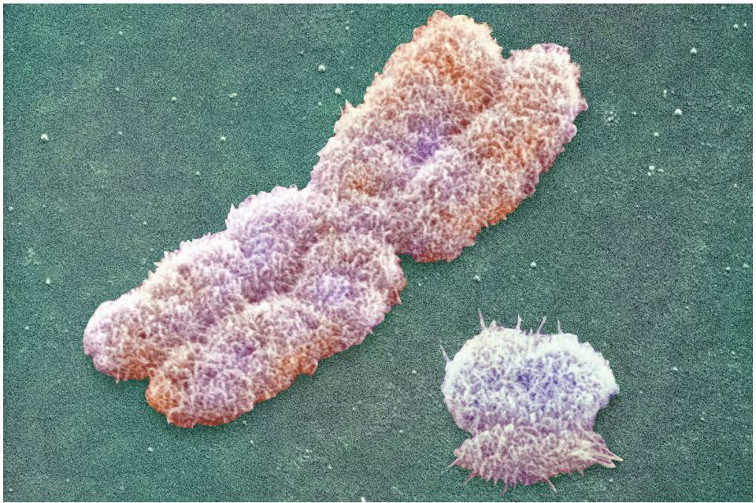
Boy or Girl? The Y Chromosome “Decides”
Y chromosome
X chromosome

Slide 29
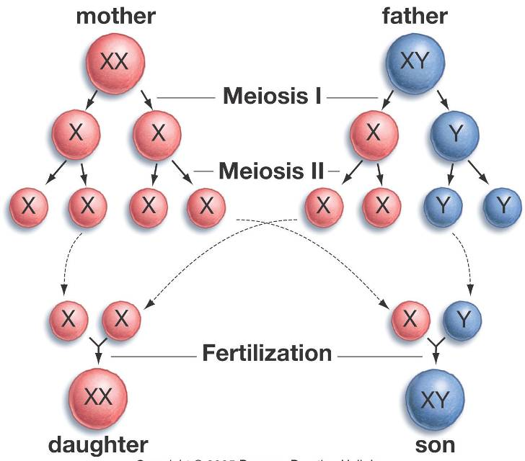
Boy or Girl? The Y Chromosome “Decides”

Slide 30
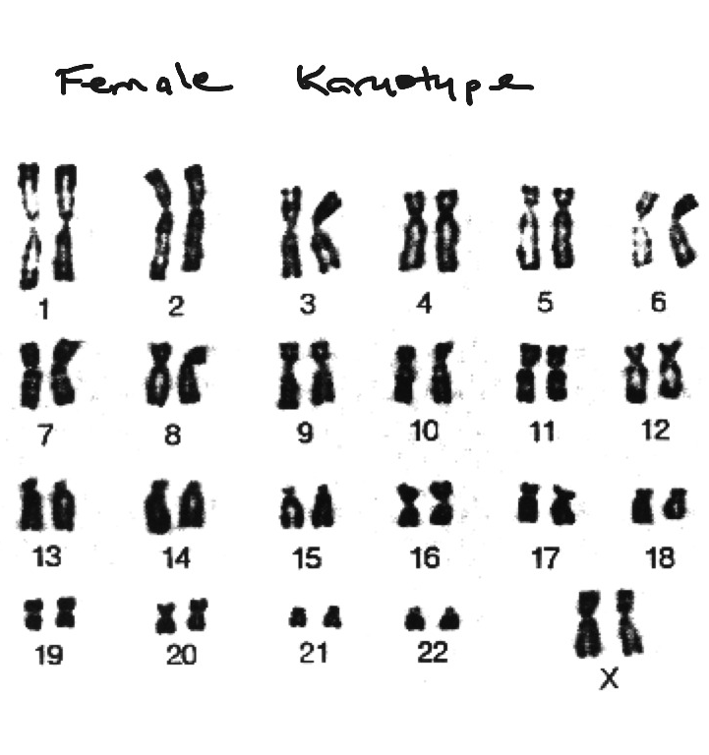
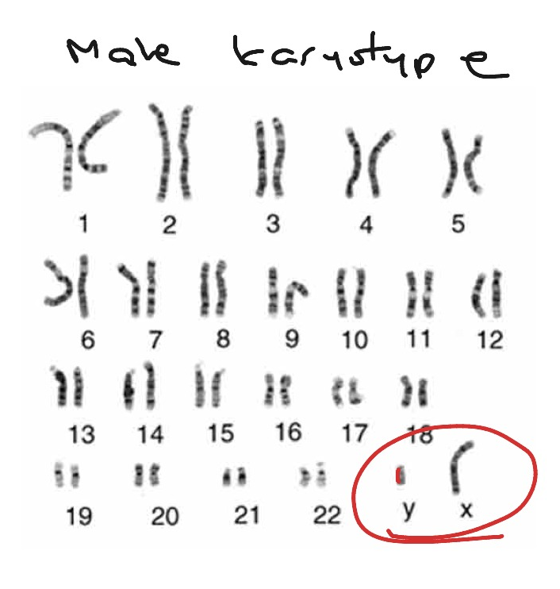

Slide 31
Mitosis vs. Meiosis

