Slide 1
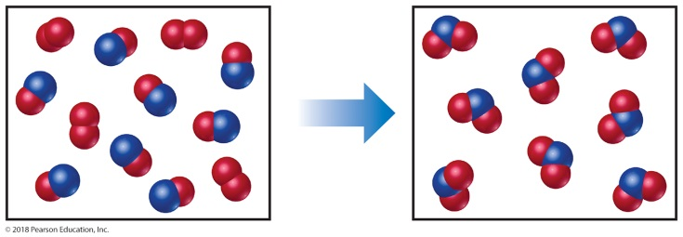
Sample Exercise 3.1 Interpreting and Balancing Chemical Equations
The following diagram represents a chemical reaction in which the red spheres are oxygen atoms and the blue spheres are nitrogen atoms. (a) Write the chemical formulas for the reactants and products. (b) Write a balanced equation for the reaction. (c) Is the diagram consistent with the law of conservation of mass?
Solution
(a) The left box, which represents reactants, contains two kinds of molecules, those composed of two oxygen atoms (O₂) and those composed of one nitrogen atom and one oxygen atom (NO). The right box, which represents products, contains only one kind of molecule, which is composed of one nitrogen atom and two oxygen atoms (NO₂).
(b) The unbalanced chemical equation is O₂ + NO NO₂ (unbalanced)
An inventory of atoms on each side of the equation shows that there are one N and three O on the left side of the arrow and one N and two O on the right. To balance O, we must increase the number of O atoms on the right while keeping the coefficients for NO and NO₂ equal. Sometimes a trial-and-error approach is required; we need to go back and forth several times from one side of an equation to the other, changing coefficients first on one side of the equation and then the other until it is balanced. In our present case, let’s start by increasing the number of O atoms on the right side of the equation by placing the coefficient 2 in front of NO₂:
O₂ + NO 2 NO₂ (unbalanced)

Slide 2
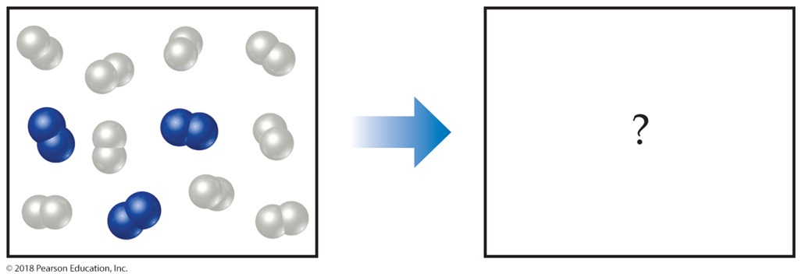
Sample Exercise 3.1 Interpreting and Balancing Chemical Equations
Continued
Now the equation gives two N atoms and four O atoms on the right, so we go back to the left side. Placing the coefficient 2 in front of NO balances both N and O:
O₂ + 2 NO 2 NO₂ (balanced)
(2 N, 4 O) (2 N, 4 O)
(c) The reactants box contains four O₂ and eight NO. Thus, the molecular ratio is one O₂ for each two NO, as required by the balanced equation. The products box contains eight NO₂, which means the number of NO₂ product molecules equals the number of NO reactant molecules, as the balanced equation requires.
There are eight N atoms in the eight NO molecules in the reactants box. There are also 4 × 2 = 8 O atoms in the O₂ molecules and 8 O atoms in the NO molecules, giving a total of 16 O atoms. In the products box, we find eight NO₂ molecules, which contain eight N atoms and NO₂ molecules, which contain eight N atoms and 8 × 2 = 16 O atoms. Because there are equal numbers of N and O atoms in the two boxes, the drawing is consistent with the law of conservation of mass.
Practice Exercise 1
In the following diagram, the white spheres represent hydrogen atoms and the blue spheres represent nitrogen atoms.

Slide 3
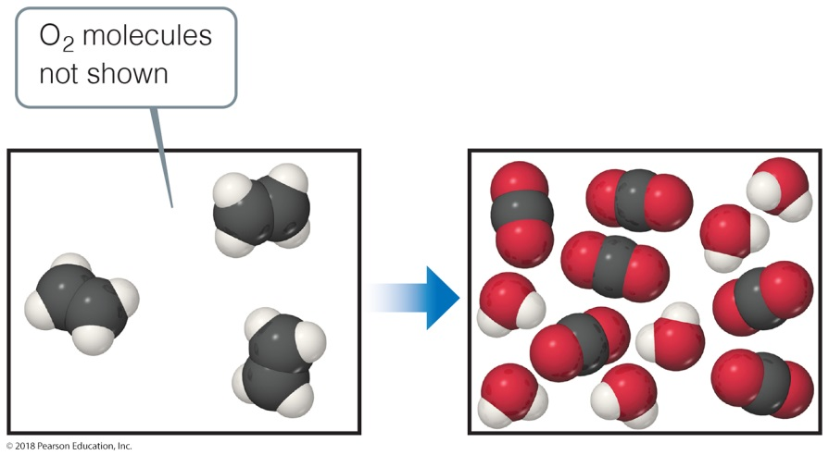
Sample Exercise 3.1 Interpreting and Balancing Chemical Equations
Continued
The two reactants combine to form a single product, ammonia, NH₃, which is not shown. Write a balanced chemical equation for the reaction. Based on the equation and the contents of the left (reactants) box, how many NH₃ molecules should be shown in the right (products) box? (a) 2, (b) 3, (c) 4, (d) 6, (e) 9.
Practice Exercise 2
In the following diagram, the white spheres represent hydrogen atoms, the black spheres carbon atoms, and the red
spheres oxygen atoms.
In this reaction, there are two reactants, ethylene, C₂H₄, which is shown, and oxygen, O₂, which is not shown, and
two products, CO₂ and H₂O, both of which are shown. (a) Write a balanced chemical equation for the reaction. (b) Determine the number of O₂ molecules that should be shown in the left (reactants) box.

Slide 4
Sample Exercise 3.2 Balancing Chemical Equations
Balance the equation
Na(s) + H₂O (l) NaOH(aq) + H₂(g)
Solution
Begin by counting each kind of atom on the two sides of the arrow. There are one Na, one O, and two H on the left side, and one Na, one O, and three H on the right. The Na and O atoms are balanced, but the number of H atoms is not. To increase the number of H atoms on the left, let’s try placing the coefficient 2 in front of H₂O:
Na(s) + 2H₂O (l) NaOH(aq) + H₂(g)
Although beginning this way does not balance H, it does increase the number of reactant H atoms, which we need to do. (Also, adding the coefficient 2 on H₂O unbalances O, but we will take care of that after we balance H.) Now that we have 2 H₂O on the left, we balance H by putting the coefficient 2 in front of NaOH:
Na(s) + 2H₂O (l) 2 NaOH(aq) + H₂(g)
Balancing H in this way brings O into balance, but now Na is unbalanced, with one Na on the left and two on the right. To rebalance Na, we put the coefficient 2 in front of the reactant:
2 Na(s) + 2H₂O (l) 2 NaOH(aq) + H₂(g)
We now have two Na atoms, four H atoms, and two O atoms on each side. The equation is balanced.

Slide 5
Sample Exercise 3.2 Balancing Chemical Equations
Continued
Comment Notice that we moved back and forth, placing a coefficient in front of H₂O, then NaOH, and finally Na. In balancing equations, we often find ourselves following this pattern of moving back and forth from one side of the arrow to the other, placing coefficients first in front of a formula on one side and then in front of a formula on the other side until the equation is balanced. You can always tell if you have balanced your equation correctly by checking that the number of atoms of each element is the same on the two sides of the arrow, and that you’ve chosen
the smallest set of coefficients that balances the equation.
Practice Exercise 1
The unbalanced equation for the reaction between methane and bromine is
__CH₄(g) + __ Br₂(l) __ CBr₄ (s) + __ HBr(g)
Once this equation is balanced, what is the value of the coefficient in front of bromine Br₂?
(a) 1, (b) 2, (c) 3, (d) 4, (e) 6.
Practice Exercise 2
Balance these equations by providing the missing coefficients:
(a) __ Fe(s) + __ O₂(g) __Fe₂O₃(s)
(b) __ Al(s) + __ HCl(aq) __ AlCl₃(aq) + __ H₂(g)
(c) __ CaCO₃(s) + __ HCl(aq) __ CaCl₂(aq) + __ CO₂(g) + __ H₂O(l)

Slide 6
Sample Exercise 3.3 Writing Balanced Equations for Combination and Decomposition Reactions
Write a balanced equation for (a) the combination reaction between lithium metal and fluorine gas and (b) the decomposition reaction that occurs when solid barium carbonate is heated (two products form, a solid and a gas).
Solution
(a) With the exception of mercury, all metals are solids at room temperature. Fluorine occurs as a diatomic molecule. Thus, the reactants are Li(s) and F₂(g). The product will be composed of a metal and a nonmetal, so we expect it to be an ionic solid. Lithium ions have a 1+ charge, Li⁺, whereas fluoride ions have a 1− charge, F⁻. Thus, the chemical formula for the product is LiF. The balanced chemical equation is
2 Li(s) + F₂(g) 2 LiF(s)
(b) The chemical formula for barium carbonate is BaCO₃. As mentioned, many metal carbonates decompose to metal oxides and carbon dioxide when heated. In Equation 3.7, for example, CaCO₃ decomposes to form CaO and CO₂. Thus, we expect BaCO₃ to decompose to BaO and CO₂. Barium and calcium are both in group 2A in the periodic table, which further suggests they react in the same way:
BaCO₃(s) BaO(s) + CO₂ (g)

Slide 7
Sample Exercise 3.3 Writing Balanced Equations for Combination and Decomposition Reactions
Continued
Practice Exercise 1
Which of the following reactions is the balanced equation that represents the decomposition reaction that occurs when silver(I) oxide is heated? (a) AgO(s) Ag(s) + O(g) (b) 2 AgO(s) 2 Ag(s) + O₂(g) (c) Ag₂O(s) 2 Ag(s) + O₂(g) (d) Ag₂O(s) 4 Ag(s) + O₂(g) (e) Ag₂O(s) 4 Ag(s) + O₂(g)
Practice Exercise 2
Write a balanced equation for (a) solid mercury(II) sulfide decomposing into its component elements when heated and (b) aluminum metal combining with oxygen in the air.

Slide 8
Sample Exercise 3.4 Writing Balanced Equations for Combustion Reactions
Write the balanced equation for the reaction that occurs when methanol, CH₃OH(l), is burned in air.
Solution
When any compound containing C, H, and O is combusted, it reacts with the O₂(g) in air to produce CO₂(g) and H₂O(g). Thus, the unbalanced equation is
CH₃OH(l) + O₂(g) CO₂(g) + H₂O(g)
The C atoms are balanced, one on each side of the arrow. Because CH₃OH has four H atoms, we place the coefficient 2 in front of H₂O to balance the H atoms:
CH₃OH(l) + O₂(g) CO₂(g) + 2 H₂O(g)
Adding this coefficient balances H but gives four O atoms in the products. Because there are only three O atoms in the reactants, we are not finished. We can place the coefficient in front of O₂ to give four O atoms in the reactants

Slide 9
Sample Exercise 3.4 Writing Balanced Equations for Combustion Reactions
Continued
Although this equation is balanced, it is not in its most conventional form because it contains a fractional coefficient. However, multiplying through by 2 removes the fraction and keeps the equation balanced:
2 CH₃OH(l) + 3O₂(g) 2 CO₂(g) + 4 H₂O(g)
Practice Exercise 1
Write the balanced equation for the reaction that occurs when ethylene glycol, C₂H₄(OH)₂, burns in air.
(a) C₂H₄(OH)₂(l) + 5 O₂(g) 2 CO₂(g) + 3 H₂O(g)
(b) 2 C₂H₄(OH)₂(l) + 5 O₂(g) 4 CO₂(g) + 6 H₂O(g)
(c) C₂H₄(OH)₂(l) + 3 O₂(g) 2 CO₂(g) + 3 H₂O(g)
(d) C₂H₄(OH)₂(l) + 5 O₂(g) 2 CO₂(g) + 3 H₂O(g)
(e) 4 C₂H₄(OH)₂(l) + 10 O₂(g) 8 CO₂(g) + 12 H₂O(g)
Practice Exercise 2
Write the balanced equation for the reaction that occurs when ethanol, C₂H₅OH(l), burns in air.

Slide 10
Sample Exercise 3.5 Calculating Formula Weights
Calculate the formula weight of (a) sucrose, C₁₂H₂₂O₁₁ (table sugar); and (b) calcium nitrate, Ca(NO₃)₂.
Solution
(a) By adding the atomic weights of the atoms in sucrose, we find the formula weight to be 342.0 amu:
(b) If a chemical formula has parentheses, the subscript outside the parentheses is a multiplier for all atoms inside. Thus, for Ca(NO₃)₂ we have
Practice Exercise 1
Which of the following is the correct formula weight for calcium phosphate?
(a) 310.2 amu, (b) 135.1 amu, (c) 182.2 amu, (d) 278.2 amu, (e) 175.1 amu.
Practice Exercise 2
Calculate the formula weight of (a) Al(OH)₃, (b) CH₃OH, and (c) TaON.

Slide 11
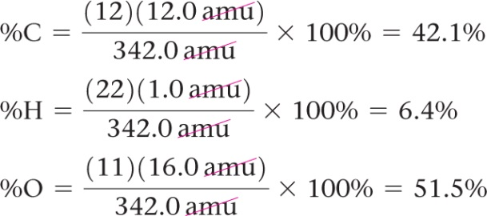
Sample Exercise 3.6 Calculating Percentage Composition
Calculate the percentage of carbon, hydrogen, and oxygen (by mass) in C₁₂H₂₂O₁₁.
Solution
We’ll use the steps outlined in the Strategies For Success: Problem Solving feature to answer the question.
Analyze We are given a chemical formula and asked to calculate the percentage by mass of each element.
Plan We use Equation 3.10, obtaining our atomic weights from a periodic table. We know the denominator in Equation 3.10, the formula weight of C₁₂H₂₂O₁₁, from Sample Exercise 3.5. We must use that value in three calculations, one for each element.
Solve
Check Our calculated percentages must add up to 100%, which they do. We could have used more significant figures for our atomic weights, giving more significant figures for our percentage composition, but we have adhered to our suggested guideline of rounding atomic weights to one digit beyond the decimal point.

Slide 12
Sample Exercise 3.6 Calculating Percentage Composition
Continued
Practice Exercise 1
What is the percentage of nitrogen, by mass, in calcium nitrate?
(a) 8.54%, (b) 17.1%, (c) 13.7%, (d) 24.4%, (e) 82.9%.
Practice Exercise 2
Calculate the percentage of potassium, by mass, in K₂PtCl₆.

Slide 13
Sample Exercise 3.7 Estimating Numbers of Atoms
Without using a calculator, arrange these samples in order of increasing numbers of carbon atoms: 12 g ¹²C, 1 mol C₂H₂, 9 × 10²³ molecules of CO₂.
Solution
Analyze We are given amounts of three substances expressed in grams, moles, and number of molecules and asked to arrange the samples in order of increasing numbers of C atoms.
Plan To determine the number of C atoms in each sample, we must convert 12 g ¹²C, 1 mol C₂H₂, and 9 × 10²³ molecules CO₂ to numbers of C atoms. To make these conversions, we use the definition of mole and Avogadro’s number.
Solve One mole is defined as the amount of matter that contains as many units of the matter as there are C atoms in exactly 12 g of ¹²C. Thus, 12 g of ¹²C contains 1 mol of C atoms = 6.02 × 10²³ C atoms.
One mol of C₂H₂ contains 6.02 × 10²³ C₂H₂ molecules. Because there are two C atoms in each molecule, this sample contains 12.04 × 10²³ C atoms.
Because each CO₂ molecule contains one C atom, the CO₂ sample contains 9 × 10²³ C atoms.
Hence, the order is 12 g ¹²C (6 × 10²³ C atoms) < 9 × 10²³ CO₂ molecules (9 × 10²³ C atoms) < 1 mol C₂H₂ (12 × 10²³ C atoms).

Slide 14
Sample Exercise 3.7 Estimating Numbers of Atoms
Continued
Check We can check our results by comparing numbers of moles of C atoms in the samples because the number of moles is proportional to the number of atoms. Thus, 12 g of ¹²C is 1 mol C, 1 mol of C₂H₂ contains 2 mol C, and 9 × 10²³ molecules of CO₂ contain 1.5 mol C, giving the same order as stated previously.
Practice Exercise 1
Determine which of the following samples contains the fewest sodium atoms?
(a) 1 mol sodium oxide, (b) 45 g sodium fluoride, (c) 50 g sodium chloride, (d) 1 mol sodium nitrate?
Practice Exercise 2
Without using a calculator, arrange these samples in order of increasing numbers of O atoms:
1 mol H₂O, 1 mol CO₂, 3 × 10²³ molecules of O₃.

Slide 15
Sample Exercise 3.8 Converting Moles to Number of Atoms
Calculate the number of H atoms in 0.350 mol of C₆H₁₂O₆.
Solution
Analyze We are given the amount of a substance (0.350 mol) and its chemical formula C₆H₁₂O₆. The unknown is the number of H atoms in the sample.
Plan Avogadro’s number provides the conversion factor between number of moles of C₆H₁₂O₆ and number of
molecules of C₆H₁₂O₆: 1 mol C₆H₁₂O₆ = 6.02 × 10²³ molecules of C₆H₁₂O₆. Once we know the number of
molecules of C₆H₁₂O₆, we can use the chemical formula, which tells us that each molecule of C₆H₁₂O₆ contains
12 H atoms. Thus, we convert moles of C₆H₁₂O₆ to molecules of C₆H₁₂O₆ and then determine the number of
atoms of H from the number of molecules of C₆H₁₂O₆:
Moles C₆H₁₂O₆ molecules C₆H₁₂O₆ atoms H
Solve

Slide 16
Sample Exercise 3.8 Converting Moles to Number of Atoms
Continued
Check We can do a ballpark calculation, figuring that 0.35(6 × 10²³) is about 2 × 10²³ molecules of C₆H₁₂O₆. We know that each one of these molecules contains 12 H atoms. 12(2 × 10²³) gives 24 × 10²³ = 2.4 × 10²⁴ H atoms, which is close to our result. Because we were asked for the number of H atoms, the units of our answer are correct. We check, too, for significant figures. The given data had three significant figures, as does our answer.
Practice Exercise 1
How many sulfur atoms are in (a) 0.45 mol BaSO₄ and (b) 1.10 mol of aluminum sulfide?
Practice Exercise 2
How many oxygen atoms are in (a) 0.25 mol Ca(NO₃)₂ and (b) 1.50 mol of sodium carbonate?

Slide 17
Sample Exercise 3.9 Calculating Molar Mass
What is the molar mass of glucose, C₆H₁₂O₆?
Solution
Analyze We are given a chemical formula and asked to determine its molar mass.
Plan Because the molar mass of any substance is numerically equal to its formula weight, we first determine the formula weight of glucose by adding the atomic weights of its component atoms. The formula weight will have units of amu, whereas the molar mass has units of grams per mole (g/mol).
Solve Our first step is to determine the formula weight of glucose:
Because glucose has a formula weight of 180.0 amu, 1 mol of this substance (6.02 × 10²³ molecules) has a mass of 180.0 g. In other words, C₆H₁₂O₆ has a molar mass of 180.0 g/mol.
Check A molar mass below 250 seems reasonable based on the earlier examples we have encountered, and grams per mole is the appropriate unit for the molar mass.

Slide 18
Sample Exercise 3.9 Calculating Molar Mass
Continued
Practice Exercise 1
A sample of an ionic compound containing iron and chlorine is analyzed and found to have a molar mass of 126.8 g/mol. What is the charge of the iron in this compound?
(a) 1+, (b) 2+, (c) 3+, (d) 4+.
Practice Exercise 2
Calculate the molar mass of Ca(NO₃)₂.

Slide 19
Sample Exercise 3.10 Converting Grams to Moles
Calculate the number of moles of glucose (C₆H₁₂O₆) in 5.380 g sample.
Solution
Analyze We are given the number of grams of a substance and its chemical formula and asked to calculate the number of moles.
Plan The molar mass of a substance provides the factor for converting grams to moles. The molar mass of C₆H₁₂O₆ is 180.0 g/mol (Sample Exercise 3.9).
Solve Using 1 mol C₆H₁₂O₆ = 180.0 g C₆H₁₂O₆ to write the appropriate conversion factor, we have
Check Because 5.380 g is less than the molar mass, an answer less than 1 mol is reasonable. The unit mol is appropriate. The original data had four significant figures, so our answer has four significant figures.
Practice Exercise 1
A 508-g sample of sodium bicarbonate (NaHCO₃) contains how many moles of sodium bicarbonate?
Practice Exercise 2
How many moles of water are in 1.00 L of water, whose density is 1.00 g/mL?

Slide 20
Sample Exercise 3.11 Converting Moles to Grams
Calculate the mass, in grams, of 0.433 mol of calcium nitrate.
Solution
Analyze We are given the number of moles and the name of a substance and asked to calculate the number of grams in the substance.
Plan To convert moles to grams, we need the molar mass, which we can calculate using the chemical formula and atomic weights.
Solve Because the calcium ion is Ca²⁺ and the nitrate ion is NO₃⁻, the chemical formula for calcium nitrate is Ca(NO₃)₂. Adding the atomic weights of the elements in the compound gives a formula weight of 164.1 amu. Using 1 mol Ca(NO₃)₂ = 164.1 g Ca(NO₃)₂ to write the appropriate conversion factor, we have
Check The number of moles is less than 1, so the number of grams must be less than the molar mass, 164.1 g. Using rounded numbers to estimate, we have 0.5 × 150 = 75 g, which means the magnitude of our answer is reasonable. Both the units (g) and the number of significant figures (3) are correct.

Slide 21
Sample Exercise 3.11 Converting Moles to Grams
Continued
Practice Exercise 1
What is the mass, in grams, of (a) 6.33 mol of NaHCO₃ and (b) 3.0 × 10⁻⁵ mol of sulfuric acid?
Practice Exercise 2
What is the mass, in grams, of (a) 0.50 mol of diamond (C) and (b) 0.155 mol of ammonium chloride?

Slide 22
Sample Exercise 3.12 Calculating Numbers of Molecules and Atoms from Mass
(a) How many glucose molecules are in 5.23 g of C₆H₁₂O₆?
(b) How many oxygen atoms are in this sample?
Solution
Analyze We are given the number of grams and the chemical formula of a substance and asked to calculate (a) the number of molecules and (b) the number of O atoms in the substance.
Plan (a) The strategy for determining the number of molecules in a given quantity of a substance is summarized in Figure 3.12. We must convert 5.23 g to moles of C₆H₁₂O₆ and then convert moles to molecules of C₆H₁₂O₆. The first conversion uses the molar mass of C₆H₁₂O₆, 180.0 g/mol, and the second conversion uses Avogadro’s number.
(b) To determine the number of O atoms, we use the fact that there are six O atoms in each C₆H₁₂O₆ molecule. Thus, multiplying the number of molecules we calculated in (a) by the factor (6 atoms O/1 molecule C₆H₁₂O₆) gives the number of O atoms.
Solve
(a) Convert grams C₆H₁₂O₆ to molecules C₆H₁₂O₆
(b) Convert molecules C₆H₁₂O₆ to atoms O.

Slide 23
Sample Exercise 3.12 Calculating Numbers of Molecules and Atoms from Mass
Continued
Check
(a) Because the mass we began with is less than a mole, there should be fewer than 6.02 × 10²³ molecules in the sample, which means the magnitude of our answer is reasonable. A ballpark estimate of the answer comes reasonably close to the answer we derived in this exercise: 5/200 = 2.5 × 10⁻² mol; (2.5 × 10⁻²)(6 × 10²³) = 15 × 10²¹ = 1.5 × 10²² molecules. The units (molecules) and the number of significant figures (three) are appropriate.
(b) The answer is six times as large as the answer to part (a), exactly what it should be. The number of significant figures (three) and the units (atoms O) are correct.
Practice Exercise 1
How many chlorine atoms are in 12.2 g of CCl₄? (a) 4.77 × 10²² (b) 7.34 × 10²⁴ (c) 1.91 × 10²³ (d) 2.07 × 10²³
Practice Exercise 2
(a) How many nitric acid molecules are in 4.20 g of HNO₃?
(b) How many O atoms are in this sample?

Slide 24
Sample Exercise 3.13 Calculating an Empirical Formula
Ascorbic acid (vitamin C) contains 40.92% C, 4.58% H, and 54.50% O by mass. What is the empirical formula of ascorbic acid?
Solution
Analyze We are to determine the empirical formula of a compound from the mass percentages of its elements.
Plan The strategy for determining the empirical formula involves the three steps given in Figure 3.13.
Solve
(1) For simplicity we assume we have exactly 100 g of material, although any other mass could also be used.
In 100.00 g of ascorbic acid we have 40.92 g C, 4.58 g H, and 54.50 g O.
(2) Next we calculate the number of moles of each element. We use atomic masses with four significant figures to match the precision of our experimental masses.

Slide 25
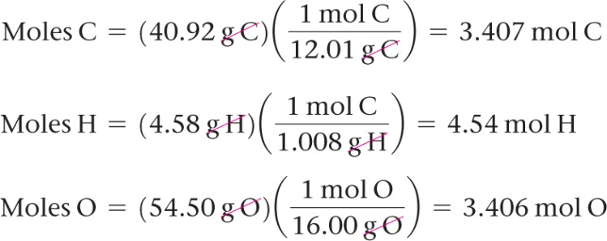
Sample Exercise 3.13 Calculating an Empirical Formula
Continued
(3) We determine the simplest whole-number ratio of moles by dividing each number of moles by the smallest number of moles.
The ratio for H is too far from 1 to attribute the difference to experimental error; in fact, it is quite close to 1 . This suggests we should multiply the ratios by 3 to obtain whole numbers:
C : H : O = (3 × 1 : 3 × 1.33 : 3 × 1) = (3 : 4 : 3)
Thus, the empirical formula is C₃H₄O₃.

Slide 26
Sample Exercise 3.13 Calculating an Empirical Formula
Continued
Check It is reassuring that the subscripts are moderate-size whole numbers. Also, calculating the percentage composition of C₃H₄O₃ gives values very close to the original percentages.
Practice Exercise 1
A 2.144-g sample of phosgene, a compound used as a chemical warfare agent during World War I, contains 0.260 g of carbon, 0.347 g of oxygen, and 1.537 g of chlorine. What is the empirical formula of this substance?
(a) CO₂Cl₆ (b) COCl₂ (c) C_{0.022}O_{0.022}Cl_{0.044} (d) C₂OCl₂
Practice Exercise 2
A 5.325-g sample of methyl benzoate, a compound used in the manufacture of perfumes, contains 3.758 g of carbon, 0.316 g of hydrogen, and 1.251 g of oxygen. What is the empirical formula of this substance?

Slide 27
Sample Exercise 3.14 Determining a Molecular Formula
Mesitylene, a hydrocarbon found in crude oil, has an empirical formula of C₃H₄ and an experimentally determined molecular weight of 121 amu. What is its molecular formula?
Solution
Analyze We are given an empirical formula and a molecular weight of a compound and asked to determine its molecular formula.
Plan The subscripts in a compound’s molecular formula are whole-number multiples of the subscripts in its empirical formula. We find the appropriate multiple by using Equation 3.11.
Solve The formula weight of the empirical formula C₃H₄ is
3(12.0 amu) + 4(1.0 amu) = 40.0 amu
Next, we use this value in Equation 3.11 :
Only whole-number ratios make physical sense because molecules contain whole atoms. The 3.03 in this case could result from a small experimental error in the molecular weight. We therefore multiply each subscript in the empirical formula by 3 to give the molecular formula: C₉H₁₂.

Slide 28
Sample Exercise 3.14 Determining a Molecular Formula
Continued
Check We can have confidence in the result because dividing molecular weight by empirical formula weight yields nearly a whole number.
Practice Exercise 1
Cyclohexane, a commonly used organic solvent, is 85.6% C and 14.4% H by mass with a molar mass of 84.2 g/mol. What is its molecular formula?
(a) C₆H (b) CH₂ (c) C₅H₂ (d) C₆H₁₂ (e) C₄H₈
Practice Exercise 2
Ethylene glycol, used in automobile antifreeze, is 38.7% C, 9.7% H, and 51.6% O by mass. Its molar mass is 62.1 g/mol. (a) What is the empirical formula of ethylene glycol? (b) What is its molecular formula?

Slide 29
Sample Exercise 3.15 Determining an Empirical Formula by Combustion Analysis
Isopropyl alcohol, sold as rubbing alcohol, is composed of C, H, and O. Combustion of 0.255 g of isopropyl alcohol produces 0.561 g of CO₂ and 0.306 g of H₂O. Determine the empirical formula of isopropyl alcohol.
Solution
Analyze We are told that isopropyl alcohol contains C, H, and O atoms and are given the quantities of CO₂ and
H₂O produced when a given quantity of the alcohol is combusted. We must determine the empirical formula for
isopropyl alcohol, a task that requires us to calculate the number of moles of C, H, and O in the sample
Plan We can use the mole concept to calculate grams of C in the CO₂ and grams of H in the H₂O—the masses of
C and H in the alcohol before combustion. The mass of O in the compound equals the mass of the original sample
minus the sum of the C and H masses. Once we have the C, H, and O masses, we can proceed as in Sample
Exercise 3.13.
Solve Because all of the carbon in the sample is converted to CO₂, we can use dimensional analysis and the
following steps to calculate the mass C in the sample.
Using the values given in this example, the mass of C is

Slide 30
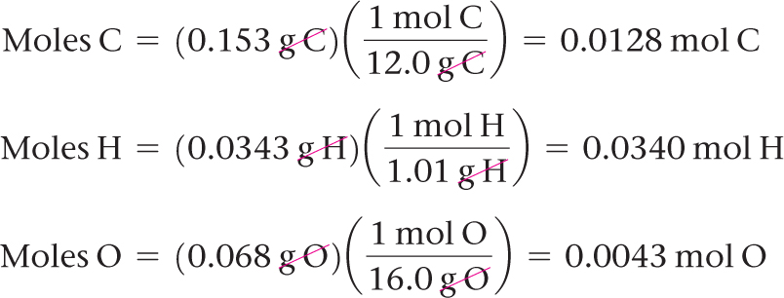
Sample Exercise 3.15 Determining an Empirical Formula by Combustion Analysis
Continued
Because all of the hydrogen in the sample is converted to H₂O, we can use dimensional analysis and the following steps to calculate the mass H in the sample. We use three significant figures for the atomic mass of H to match the significant figures in the mass of H₂O produced.
Using the values given in this example, we find that the mass of H is
The mass of the sample, 0.255 g, is the sum of the masses of C, H, and O. Thus, the O mass is
Mass of O = mass of sample – (mass of C + mass of H) = 0.255 g – (0.153 g + 0.0343 g) = 0.068 g O
The number of moles of C, H, and O in the sample is therefore

Slide 31
Sample Exercise 3.15 Determining an Empirical Formula by Combustion Analysis
Continued
To find the empirical formula, we must compare the relative number of moles of each element in the sample, as illustrated in Sample Exercise 3.13.
The first two numbers are very close to the whole numbers 3 and 8, giving the empirical formula C₃H₈O.
Practice Exercise 1
The compound dioxane, which is used as a solvent in various industrial processes, is composed of C, H, and O atoms. Combustion of a 2.203-g sample of this compound produces 4.401 g CO₂ and 1.802 g H₂O. A separate experiment shows that it has a molar mass of 88.1 g/mol. Which of the following is the correct molecular formula for dioxane?
(a) C₂H₄O (b) C₄H₄O₂ (c) CH₂ (d) C₄H₈O₂
Practice Exercise 2
(a) Caproic acid, responsible for the odor of dirty socks, is composed of C, H, and O atoms. Combustion of a 0.225-g sample of this compound produces 0.512 g CO₂ and 0.209 g H₂O. What is the empirical formula of caproic acid?
(b) Caproic acid has a molar mass of 116 g/mol. What is its molecular formula?

Slide 32
Sample Exercise 3.16 Calculating Amounts of Reactants and Products
Determine how many grams of water are produced in the oxidation of 1.00 g of glucose, C₆H₁₂O₆:
C₆H₁₂O₆(s) + 6 O₂(g) 6 CO₂(g) + 6 H₂O(l)
Solution
Analyze We are given the mass of a reactant and must determine the mass of a product in the given reaction.
Plan We follow the general strategy outlined in Figure 3.16:
(1) Convert grams of C₆H₁₂O₆ to moles using the molar mass of C₆H₁₂O₆.
(2) Convert moles of C₆H₁₂O₆ to moles of H₂O using the stoichiometric relationship 1 mol C₆H₁₂O₆ 6 mol H₂O.
(3) Convert moles of H₂O to grams using the molar mass of H₂O.
Solve
(1) First we convert grams of C₆H₁₂O₆ to moles using the molar mass of C₆H₁₂O₆.

Slide 33
Sample Exercise 3.16 Calculating Amounts of Reactants and Products
Continued
(2) Next we convert moles of C₆H₁₂O₆ to moles of H₂O using the stoichiometric relationship 1 mol C₆H₁₂O₆ 6 mol H₂O.
(3) Finally, we convert moles of H₂O to grams using the molar mass of H₂O.
Check We can check how reasonable our result is by doing a ballpark estimate of the mass of H₂O. Because the molar mass of glucose is 180 g/mol, 1 g of glucose equals 1/180 mol. Because 1 mol of glucose yields 6 mol H₂O, we would have 6/180 = 1/30 mol H₂O. The molar mass of water is 18 g/mol, so we have 1/30 × 18 = 6/10 = 0.6 g of H₂O, which agrees with the full calculation. The units, grams H₂O, are correct. The initial data had three significant figures, so three significant figures for the answer is correct.

Slide 34
Sample Exercise 3.16 Calculating Amounts of Reactants and Products
Continued
Practice Exercise 1
Sodium hydroxide reacts with carbon dioxide to form sodium carbonate and water:
2 NaOH(s) + CO₂(g) Na₂CO₃(s) + H₂O(l)
How many grams of Na₂CO₃ can be prepared from 2.40 g of NaOH?
(a) 3.18 g, (b) 6.36 g, (c) 1.20 g, (d) 0.0300 g.
Practice Exercise 2
Decomposition of KClO₃ is sometimes used to prepare small amounts of O₂ in the laboratory: 2 KClO₃(s) 2 KCl(s) + 3 O₂(g). How many grams of O₂ can be prepared from 4.50 g of KClO₃?

Slide 35
Sample Exercise 3.17 Calculating Amounts of Reactants and Products
Solid lithium hydroxide is used in space vehicles to remove the carbon dioxide gas exhaled by astronauts. The hydroxide reacts with the carbon dioxide to form solid lithium carbonate and liquid water. How many grams of carbon dioxide can be absorbed by 1.00 g of lithium hydroxide?
Solution
Analyze We are given a verbal description of a reaction and asked to calculate the number of grams of one reactant that reacts with 1.00 g of another.
Plan The verbal description of the reaction can be used to write a balanced equation:
2 LiOH(s) + CO₂(g) Li₂CO₃(s) + H₂O(l)
We are given the mass in grams of LiOH and asked to calculate the mass in grams of CO₂. We can accomplish this with the three conversion steps in Figure 3.16. The conversion of Step 1 requires the molar mass of LiOH 6.94 + 16.00 + 1.01 = 23.95 g/mol). The conversion of Step 2 is based on a stoichiometric relationship from the balanced chemical equation: 2 mol LiOH 1mol CO₂. For the Step 3 conversion, we use the molar mass of
CO₂ : 12.01 + 2(16.00) = 44.01 g/mol.
Solve

Slide 36
Sample Exercise 3.17 Calculating Amounts of Reactants and Products
Continued
Check Notice that 23.95 g LiOH/mol ≈ 24 g LiOH/mol, 24 g LiOH/mol × 2 mol LiOH = 48 g LiOH, and (44 g CO₂/mol)/(48 g LiOH) is slightly less than 1. Thus, the magnitude of our answer, 0.919 g CO₂, is reasonable based on the amount of starting LiOH. The number of significant figures and units are also appropriate.
Practice Exercise 1
Propane, C₃H₈ (Figure 3.8), is a common fuel used for cooking and home heating. What mass of O₂ is consumed in the combustion of 1.00 g of propane?
(a) 5.00 g (b) 0.726 g (c) 2.18 g (d) 3.63 g
Practice Exercise 2
Methanol, CH₃OH, reacts with oxygen from air in a combustion reaction to form water and carbon dioxide. What
mass of water is produced in the combustion of 23.6 g of methanol?

Slide 37
Sample Exercise 3.18 Calculating the Amount of Product Formed from a Limiting Reactant
The most important commercial process for converting N₂ from the air into nitrogen-containing compounds is based on the reaction of N₂ and H₂ to form ammonia (NH₃):
N₂(g) + 3 H₂(g) 2 NH₃(g)
How many moles of NH₃ can be formed from 3.0 mol of N₂ and 6.0 mol of H₂?
Solution
Analyze We are asked to calculate the number of moles of product, NH₃, given the quantities of each reactant, N₂ and H₂, available in a reaction. This is a limiting reactant problem.
Plan If we assume one reactant is completely consumed, we can calculate how much of the second reactant is needed. By comparing the calculated quantity of the second reactant with the amount available, we can determine which reactant is limiting. We then proceed with the calculation, using the quantity of the limiting reactant.
Solve The number of moles of H₂ needed for complete consumption of 3.0 mol of N₂ is

Slide 38
Sample Exercise 3.18 Calculating the Amount of Product Formed from a Limiting Reactant
Continued
Because only 6.0 mol H₂ is available, we will run out of H₂ before the N₂ is gone, which tells us that H₂ is the limiting reactant. Therefore, we use the quantity of H₂ to calculate the quantity of NH₃ produced:
Notice that we can calculate not only the number of moles of NH₃ formed but also the number of moles of each reactant remaining after the reaction. Notice also that although the initial (before) number of moles of H₂ is greater than the final (after) number of moles of N₂, H₂ is nevertheless the limiting reactant because of its larger coefficient in the balanced equation.
Check Examine the change row of the summary table to see that the mole ratio of reactants consumed and product formed, 2:6:4, is a multiple of the coefficients in the balanced equation, 1:3:2. We confirm that H₂ is the limiting reactant because it is completely consumed in the reaction, leaving 0 mol at the end. Because 6.0 mol H₂ has two significant figures, our answer has two significant figures.
Comment It is useful to summarize the reaction data in a table:

Slide 39
Sample Exercise 3.18 Calculating the Amount of Product Formed from a Limiting Reactant
Continued
Practice Exercise 1
When 24 mol of methanol and 15 mol of oxygen combine in the combustion reaction 2 CH₃OH(l) + 3 O₂(g) 2 CO₂(g) + 4 H₂O(g), what is the excess reactant and how many moles of it remains at the end of the reaction?
(a) 9 mol CH₃OH(l) (b) 10 mol CO₂(g) (c) 10 mol CH₃OH(l) (d) 14 mol CH₃OH(l) (e) 1 mol O₂(g)
Practice Exercise 2
(a) When 1.50 mol of Al and 3.00 mol of Cl₂ combine in the reaction 2 Al(s) + 3 Cl₂(g) 2 AlCl₃(s), which is the limiting reactant? (b) How many moles of AlCl₃ are formed? (c) How many moles of the excess reactant remain at the end of the reaction?

Slide 40
Sample Exercise 3.19 Calculating the Amount of Product Formed from a Limiting Reactant
The reaction
2 H₂(g) + O₂(g) 2 H₂O(g)
is used to produce electricity in a hydrogen fuel cell. Suppose a fuel cell contains 150 g of H₂(g) and 1500 g of O₂(g) (each measured to two significant figures). How many grams of water can form?
Solution
Analyze We are asked to calculate the amount of a product, given the amounts of two reactants, so this is a limiting reactant problem.
Plan To identify the limiting reactant, we can calculate the number of moles of each reactant and compare their ratio with the ratio of coefficients in the balanced equation. We then use the quantity of the limiting reactant to calculate the mass of water that forms.
Solve From the balanced equation, we have the stoichiometric relations

Slide 41
Sample Exercise 3.19 Calculating the Amount of Product Formed from a Limiting Reactant
Continued
Using the molar mass of each substance, we calculate the number of moles of each reactant:
The coefficients in the balanced equation indicate that the reaction requires 2 mol of H₂ for every 1 mol of O₂. Therefore, for all the O₂ to completely react, we would need 2 × 47 = 94 mol of H₂. Since there are only 74 mol of H₂, all of the O₂ cannot react, so it is the excess reactant, and H₂ must be the limiting reactant. (Notice that the limiting reactant is not necessarily the one present in the lowest amount.)
We use the given quantity of H₂ (the limiting reactant) to calculate the quantity of water formed. We could begin this calculation with the given H₂ mass, 150 g, but we can save a step by starting with the moles of H₂, 74 mol, we just calculated:

Slide 42
Sample Exercise 3.19 Calculating the Amount of Product Formed from a Limiting Reactant
Continued
Check The magnitude of the answer seems reasonable based on the amounts of the reactants. The units are correct, and the number of significant figures (two) corresponds to those in the values given in the problem statement.
Comment The quantity of the limiting reactant, H₂, can also be used to determine the quantity of O₂ used:
The mass of O₂ remaining at the end of the reaction equals the starting amount minus the amount consumed:
1500 g − 1200 g = 300 g.
Practice Exercise 1
Molten gallium reacts with arsenic to form the semiconductor, gallium arsenide, GaAs, used in light–emitting diodes and solar cells:
Ga(l) + As(s) GaAs(s)
If 4.00 g of gallium is reacted with 5.50 g of arsenic, how many grams of the excess reactant are left at the end of the reaction?
(a) 1.20 g As (b) 1.50 g As (c) 4.30 g As (d) 8.30 g Ga

Slide 43
Sample Exercise 3.19 Calculating the Amount of Product Formed from a Limiting Reactant
Continued
Practice Exercise 2
When a 2.00-g strip of zinc metal is placed in an aqueous solution containing 2.50 g of silver nitrate, the reaction is
Zn(s) + 2 AgNO₃(aq) 2 Ag(s) + Zn(NO₃)₂(aq)
(a) Which reactant is limiting? (b) How many grams of Ag form? (c) How many grams of Zn(NO₃)₂ form? (d) How many grams of the excess reactant are left at the end of the reaction?

Slide 44
Sample Exercise 3.20 Calculating Theoretical Yield and Percent Yield
Adipic acid, H₂C₆H₈O₄, used to produce nylon, is made commercially by a reaction between cyclohexane (C₆H₁₂) and O₂:
2 C₆H₁₂ (l) + 5 O₂(g) 2 H₂C₆H₈O₄(l) + 2 H₂O(g)
(a) Assume that you carry out this reaction with 25.0 g of cyclohexane and that cyclohexane is the limiting reactant. What is the theoretical yield of adipic acid? (b) If you obtain 33.5 g of adipic acid, what is the percent yield for the reaction?
Solution
Analyze We are given a chemical equation and the quantity of the limiting reactant (25.0 g of C₆H₁₂). We are asked to calculate the theoretical yield of a product H₂C₆H₈O₄ and the percent yield if only 33.5 g of product is obtained.
Plan
(a) The theoretical yield, which is the calculated quantity of adipic acid formed, can be calculated using the sequence of conversions shown in Figure 3.16.
(b) The percent yield is calculated by using Equation 3.14 to compare the given actual yield (33.5 g) with the theoretical yield.
Solve
(a) The theoretical yield is:

Slide 45
Sample Exercise 3.20 Calculating Theoretical Yield and Percent Yield
Continued
(b) The percent yield is:
Check We can check our answer in (a) by doing a ballpark calculation. From the balanced equation we know that each mole of cyclohexane gives 1 mol adipic acid. We have 25/84 ≈ 25/75 = 0.3 mol hexane, so we expect 0.3 mol adipic acid, which equals about 0.3 × 150 = 45 g, about the same magnitude as the 43.5 g obtained in the more detailed calculation given previously. In addition, our answer has the appropriate units and number of significant figures. In (b) the answer is less than 100%, as it must be from the definition of percent yield.
Practice Exercise 1
If 3.00 g of titanium metal is reacted with 6.00 g of chlorine gas, Cl₂, to form 7.7 g of titanium(IV) chloride in a combination reaction, what is the percent yield of the product?
(a) 65% (b) 96% (c) 48% (d) 86%
Practice Exercise 2
Imagine you are working on ways to improve the process by which iron ore containing Fe₂O₃ is converted into iron: (a) If you start with 150 g of Fe₂O₃ as the limiting reactant, what is the theoretical yield of Fe?
(b) If your actual yield is 87.9 g, what is the percent yield?

