Slide 1
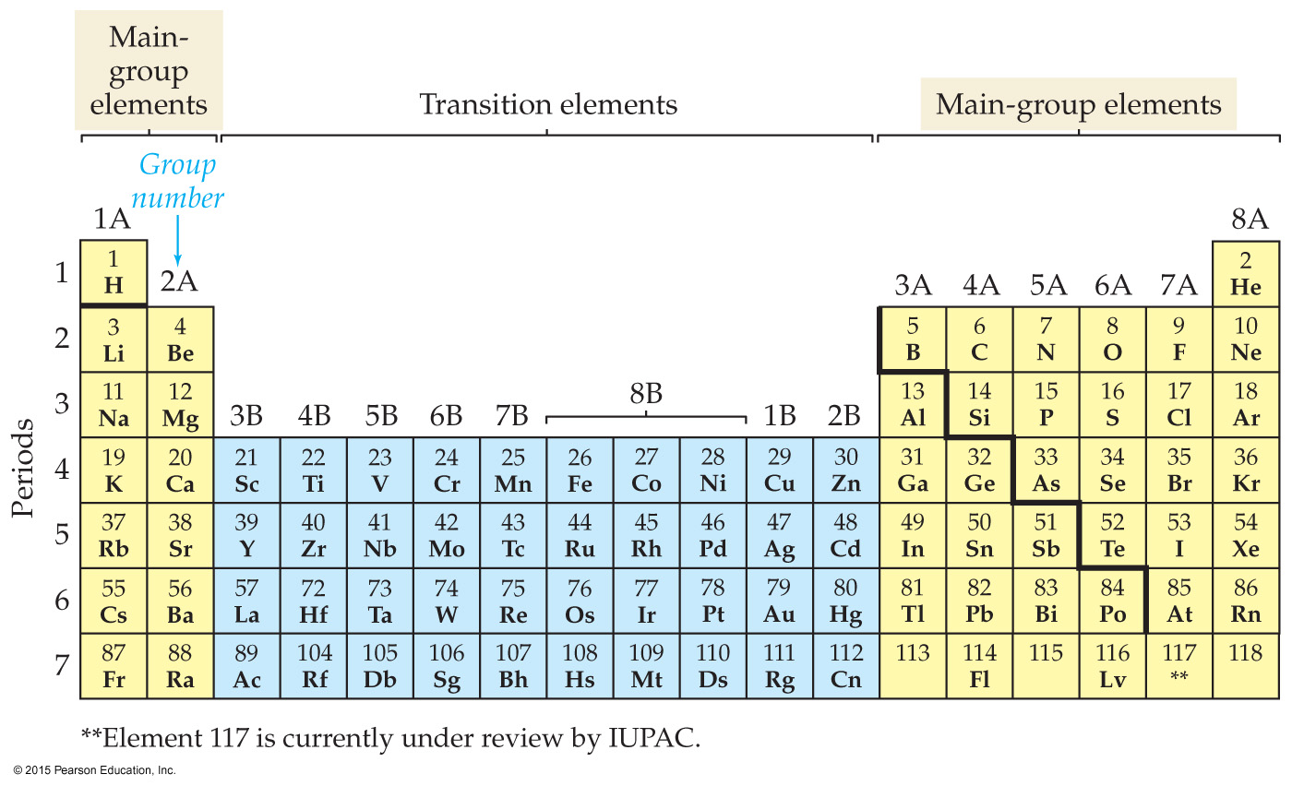
The mass ratio of lead to sulfur in lead(II) sulfide is 270.0 g lead to 41.8 g sulfur. How much lead is required to completely react with 85.6 g of sulfur?
13.3 g
185 g
228 g
312 g
553 g
Notes:
Answer: E

Slide 2
The mass ratio of lead to sulfur in lead(II) sulfide is 270.0 g lead to 41.8 g sulfur. How much lead is required to completely react with 85.6 g of sulfur?
13.3 g
185 g
228 g
312 g
553 g
Notes:
Answer: E

Slide 3
How many hydrogen atoms are in the formula for ammonium phosphate, (NH₄)₃PO₄?
1
3
4
7
12
Notes:
Answer: E

Slide 4
How many hydrogen atoms are in the formula for ammonium phosphate, (NH₄)₃PO₄?
1
3
4
7
12
Notes:
Answer: E

Slide 5
What is the hydrogen to carbon mass ratio of methane (CH₄)?
1
0.33
3
4
0.25
Notes:
Answer: B

Slide 6
What is the hydrogen to carbon mass ratio of methane (CH₄)?
1
0.33
3
4
0.25
Notes:
Answer: B

Slide 7
Which is the chemical formula of the compound containing two phosphorus atoms and five oxygen atoms?
2P5O
P₂O₅
OP
P_{2.5}O
P₅O₂
Notes:
Answer: B

Slide 8
Which is the chemical formula of the compound containing two phosphorus atoms and five oxygen atoms?
2P5O
P₂O₅
OP
P_{2.5}O
P₅O₂
Notes:
Answer: B

Slide 9
What is the total number of atoms in a molecule of glucose, C₆H₁₂O₆?
3
4
6
12
24
Notes:
Answer: E

Slide 10
What is the total number of atoms in a molecule of glucose, C₆H₁₂O₆?
3
4
6
12
24
Notes:
Answer: E

Slide 11
How many different kinds of atoms are in a molecule of penicillin, C₁₄H₂₀N₂SO₄?
42
40
34
5
1
Notes:
Answer: D

Slide 12
How many different kinds of atoms are in a molecule of penicillin, C₁₄H₂₀N₂SO₄?
42
40
34
5
1
Notes:
Answer: D

Slide 13
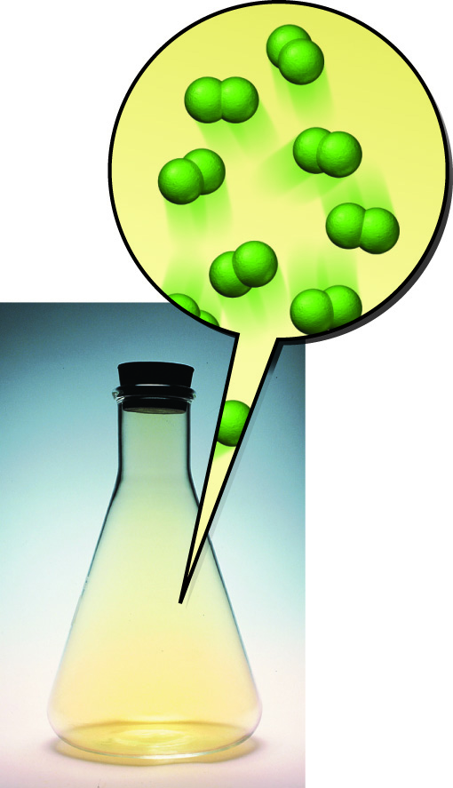
Which of these elements is a diatomic gas at room temperature?
Bromine
Iodine
Neon
Chlorine
Sulfur
Notes:
Answer: D

Slide 14
Which of these elements is a diatomic gas at room temperature?
Bromine
Iodine
Neon
Chlorine
Sulfur
Notes:
Answer: D

Slide 15
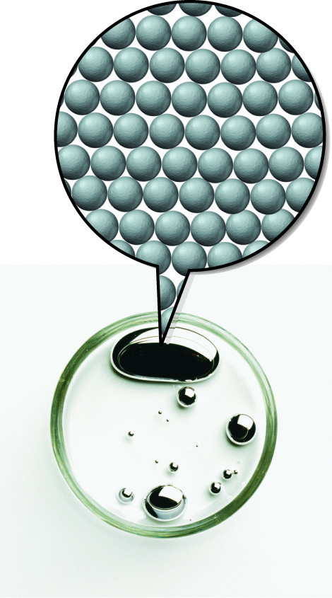
Which of the following species is an atomic element?
Mercury
NaCl
Oxygen gas
CO₂
H₂
Notes:
Answer: A

Slide 16
Which of the following species is an atomic element?
Mercury
NaCl
Oxygen gas
CO₂
H₂
Notes:
Answer: A

Slide 17
Aluminum carbonate is considered which of the following?
Atomic element
Molecular element
Molecular compound
Ionic compound
Diatomic molecule
Notes:
Answer: D

Slide 18
Aluminum carbonate is considered which of the following?
Atomic element
Molecular element
Molecular compound
Ionic compound
Diatomic molecule
Notes:
Answer: D

Slide 19
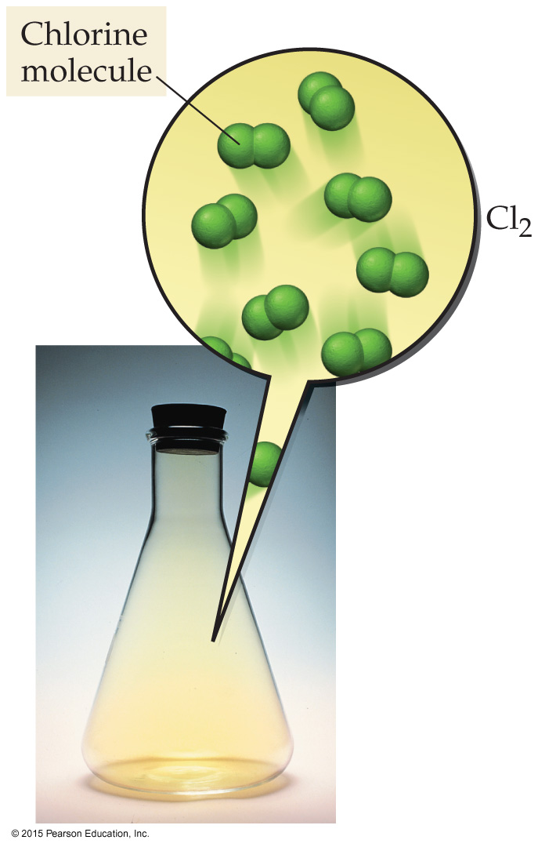
How many elements occur as diatomic molecules?
4
6
3
10
7
Notes:
Answer: E

Slide 20
How many elements occur as diatomic molecules?
4
6
3
10
7
Notes:
Answer: E

Slide 21
What is the formula of the compound formed from lithium and nitrogen?
LiN₂
Li₂N₃
Li₃N₂
Li₃N
LiN
Notes:
Answer: D

Slide 22
What is the formula of the compound formed from lithium and nitrogen?
LiN₂
Li₂N₃
Li₃N₂
Li₃N
LiN
Notes:
Answer: D

Slide 23
The name of the compound AgCl is
silver chlorine.
silver chloride.
silver(I) chloride.
silver monochloride.
monosilver monochloride.
Notes:
Answer: B

Slide 24
The name of the compound AgCl is
silver chlorine.
silver chloride.
silver(I) chloride.
silver monochloride.
monosilver monochloride.
Notes:
Answer: B

Slide 25
The name of the compound Fe₂O₃ is
iron oxide.
iron(II) oxide.
iron(III) oxide.
diiron trioxide.
iron(II) oxide(III).
Notes:
Answer: C

Slide 26
The name of the compound Fe₂O₃ is
iron oxide.
iron(II) oxide.
iron(III) oxide.
diiron trioxide.
iron(II) oxide(III).
Notes:
Answer: C

Slide 27
Identify the formulas of the following oxyanions in their correct order: sulfate ion and sulfite ion.
SO₄– and SO₃–
SO₃– and SO₄–
SO₄^{2–} and SO₃^{2–}
SO₃^{2–} and SO₄^{2–}
SO₄^{2–} and SO₃–
Notes:
Answer: C

Slide 28
Identify the formulas of the following oxyanions in their correct order: sulfate ion and sulfite ion.
SO₄– and SO₃–
SO₃– and SO₄–
SO₄^{2–} and SO₃^{2–}
SO₃^{2–} and SO₄^{2–}
SO₄^{2–} and SO₃–
Notes:
Answer: C

Slide 29
What is the formula of the ammonium ion?
NH₃⁺
NH₃
NH₄²⁺
NH₄
NH₄⁺
Notes:
Answer: E

Slide 30
What is the formula of the ammonium ion?
NH₃⁺
NH₃
NH₄²⁺
NH₄
NH₄⁺
Notes:
Answer: E

Slide 31
Name the following polyatomic ions in their listed order: OH–, CO₃^{2–}, and PO₄^{3–}.
Hydroxide ion, carbonate ion, phosphate ion
Oxide ion, carbonate ion, phosphate ion
Hydroxide ion, carbonate ion, phosphite ion
Hydroxide ion, carbonite ion, phosphate ion
Oxide ion, carbonate ion, phosphite ion
Notes:
Answer: A

Slide 32
Name the following polyatomic ions in their listed order: OH–, CO₃^{2–}, and PO₄^{3–}.
Hydroxide ion, carbonate ion, phosphate ion
Oxide ion, carbonate ion, phosphate ion
Hydroxide ion, carbonate ion, phosphite ion
Hydroxide ion, carbonite ion, phosphate ion
Oxide ion, carbonate ion, phosphite ion
Notes:
Answer: A

Slide 33
The name of the compound NH₄ClO₄ is
ammonium chloride.
ammonium chlorite.
ammonium hypochlorite.
ammonium chlorate.
ammonium perchlorate.
Notes:
Answer: E

Slide 34
The name of the compound NH₄ClO₄ is
ammonium chloride.
ammonium chlorite.
ammonium hypochlorite.
ammonium chlorate.
ammonium perchlorate.
Notes:
Answer: E

Slide 35
The name of the compound SnO₂ is
stannium oxide.
stannium(II) oxide.
stannium(IV) oxide.
tin(II) oxide.
tin(IV) oxide.
Notes:
Answer: E

Slide 36
The name of the compound SnO₂ is
stannium oxide.
stannium(II) oxide.
stannium(IV) oxide.
tin(II) oxide.
tin(IV) oxide.
Notes:
Answer: E

Slide 37
The name of the compound PI₃ is
phosphorus iodide.
monophosphorus triiodide.
phosphorus triiodide.
phosphorus(III) iodide.
potassium iodide.
Notes:
Answer: C

Slide 38
The name of the compound PI₃ is
phosphorus iodide.
monophosphorus triiodide.
phosphorus triiodide.
phosphorus(III) iodide.
potassium iodide.
Notes:
Answer: C

Slide 39
The name of the compound HCN(aq) is
cyanic acid.
hydrogen cyanide.
percyanic acid.
hydrocyanic acid.
hypocyanous acid.
Notes:
Answer: D

Slide 40
The name of the compound HCN(aq) is
cyanic acid.
hydrogen cyanide.
percyanic acid.
hydrocyanic acid.
hypocyanous acid.
Notes:
Answer: D

Slide 41
The name of the compound HCl(g) is
hydrochloric acid.
hydrogen chloride.
hypochlorous acid.
chloric acid.
hypochloric acid.
Notes:
Answer: B

Slide 42
The name of the compound HCl(g) is
hydrochloric acid.
hydrogen chloride.
hypochlorous acid.
chloric acid.
hypochloric acid.
Notes:
Answer: B

Slide 43
Which is the correct formula for chloric acid?
HClO
HClO₂
HClO₃
HClO₄
HClO₅
Notes:
Answer: C

Slide 44
Which is the correct formula for chloric acid?
HClO
HClO₂
HClO₃
HClO₄
HClO₅
Notes:
Answer: C

Slide 45
Which is the correct formula for nickel(II) carbonate?
NiCO₃
Ni₂CO₃
Ni(CO₃)₂
NiC
Ni₃(CO₂)₂
Notes:
Answer: A

Slide 46
Which is the correct formula for nickel(II) carbonate?
NiCO₃
Ni₂CO₃
Ni(CO₃)₂
NiC
Ni₃(CO₂)₂
Notes:
Answer: A

Slide 47
Which is the correct formula for ammonium dichromate?
NH₄Cr₂
NH₄Cr₂O₄
(NH₄)₂Cr₂O₄
NH₄Cr₂O₇
(NH₄)₂Cr₂O₇
Notes:
Answer: E

Slide 48
Which is the correct formula for ammonium dichromate?
NH₄Cr₂
NH₄Cr₂O₄
(NH₄)₂Cr₂O₄
NH₄Cr₂O₇
(NH₄)₂Cr₂O₇
Notes:
Answer: E

Slide 49
What is the correct formula for dinitrogen tetrahydride?
N₂H₃
N₂H₄
N₂H₅
Ni₂H₄
N₂OH₄
Notes:
Answer: B

Slide 50
What is the correct formula for dinitrogen tetrahydride?
N₂H₃
N₂H₄
N₂H₅
Ni₂H₄
N₂OH₄
Notes:
Answer: B

Slide 51
Which of the following contains the correct formula and name?
HF (aq), hypofluorous acid
Na₂HCO₃, sodium bicarbonate
PbO₂, lead oxide
SF₆, sulfur heptafluoride
HNO₂, nitrous acid
Notes:
Answer: E

Slide 52
Which of the following contains the correct formula and name?
HF (aq), hypofluorous acid
Na₂HCO₃, sodium bicarbonate
PbO₂, lead oxide
SF₆, sulfur heptafluoride
HNO₂, nitrous acid
Notes:
Answer: E

Slide 53
Which of the following is named incorrectly?
H₂SO₄(aq), sulfuric acid
SiO₂, silicon dioxide
CuCl₂, copper(II) chloride
Zn(OH)₂, zinc(II) hydroxide
NaClO, sodium hypochlorite
Notes:
Answer: D

Slide 54
Which of the following is named incorrectly?
H₂SO₄(aq), sulfuric acid
SiO₂, silicon dioxide
CuCl₂, copper(II) chloride
Zn(OH)₂, zinc(II) hydroxide
NaClO, sodium hypochlorite
Notes:
Answer: D

Slide 55
What is the formula mass of sodium sulfite?
215.1 amu
119.1 amu
126.0 amu
142.1 amu
125.1 amu
Notes:
Answer: C

Slide 56
What is the formula mass of sodium sulfite?
215.1 amu
119.1 amu
126.0 amu
142.1 amu
125.1 amu
Notes:
Answer: C

Slide 57
What is the formula mass of (NH₄)₂SO₄?
215.1 amu
119.1 amu
126.0 amu
132.1 amu
114.1 amu
Notes:
Answer: D

Slide 58
What is the formula mass of (NH₄)₂SO₄?
215.1 amu
119.1 amu
126.0 amu
132.1 amu
114.1 amu
Notes:
Answer: D

Slide 59
How many nitrogen atoms are in the formula for ammonium phosphate, (NH₄)₃PO₄?
1
3
4
7
12
Notes:
Answer: B

Slide 60
How many nitrogen atoms are in the formula for ammonium phosphate, (NH₄)₃PO₄?
1
3
4
7
12
Notes:
Answer: B

Slide 61
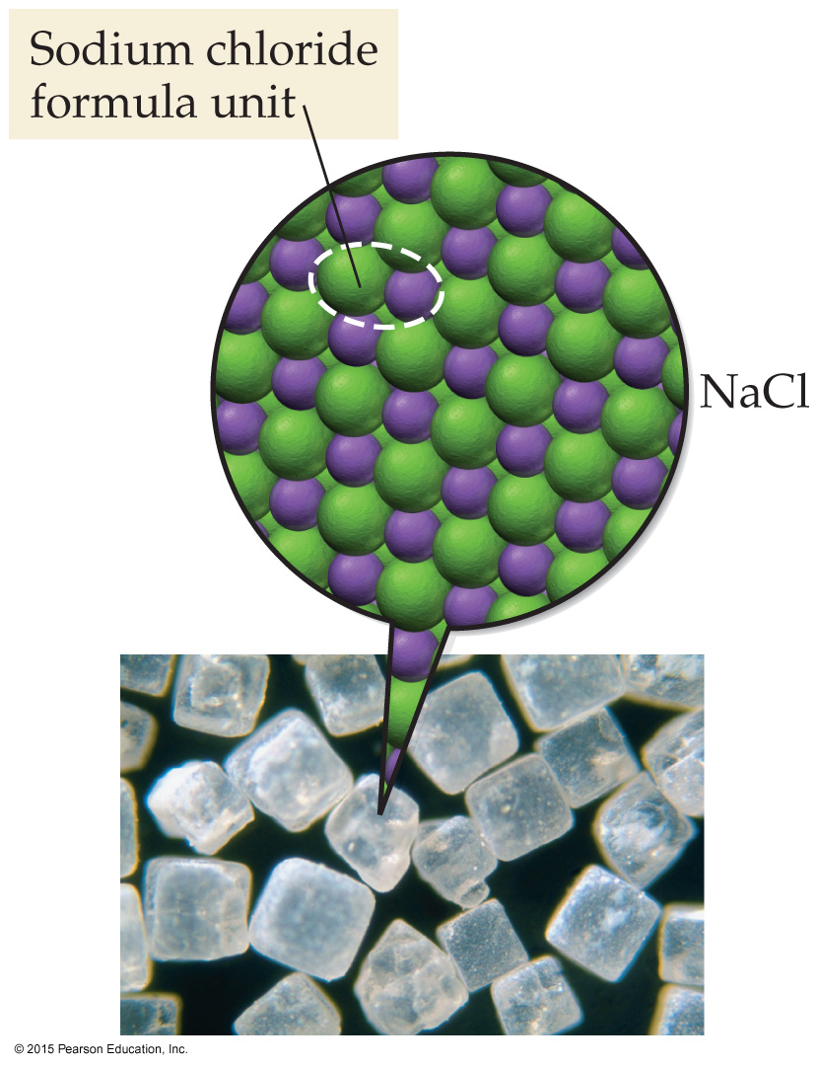
What are the basic units of the compound sodium chloride?
Diatomic molecules
Atoms
Molecules
Formula units
Monomers
Notes:
Answer: D

Slide 62
What are the basic units of the compound sodium chloride?
Diatomic molecules
Atoms
Molecules
Formula units
Monomers
Notes:
Answer: D

Slide 63
Which of the following are polyatomic ions?
N^{3–}
HCl(aq)
NO₃–
NH₄⁺
Two of the above
Notes:
Answer: E

Slide 64
Which of the following are polyatomic ions?
N^{3–}
HCl(aq)
NO₃–
NH₄⁺
Two of the above
Notes:
Answer: E

Slide 65
How is the compound I₂O₅ named?
Diiodine pentoxygen
Diiodine tetroxide
Pentoxide of iodine
Iodine oxide
Diiodine pentoxide
Notes:
Answer: E

Slide 66
How is the compound I₂O₅ named?
Diiodine pentoxygen
Diiodine tetroxide
Pentoxide of iodine
Iodine oxide
Diiodine pentoxide
Notes:
Answer: E

Slide 67
How can the following equation be best interpreted? 4 Al + 3 O₂ → 2 Al₂O₃
1 mole Al reacts with 3 moles O₂.
1 mole Al produces 1 mole of Al₂O₃.
1 mole Al produces 0.5 mole Al₂O₃.
1 mole Al reacts with 2 moles of O₂.
1 mole Al cannot react with O₂.
Notes:
Answer: D

Slide 68
How can the following equation be best interpreted? 4 Al + 3 O₂ → 2 Al₂O₃
1 mole Al reacts with 3 moles O₂.
1 mole Al produces 1 mole of Al₂O₃.
1 mole Al produces 0.5 mole Al₂O₃.
1 mole Al reacts with 2 moles of O₂.
1 mole Al cannot react with O₂.
Notes:
Answer: D

Slide 69
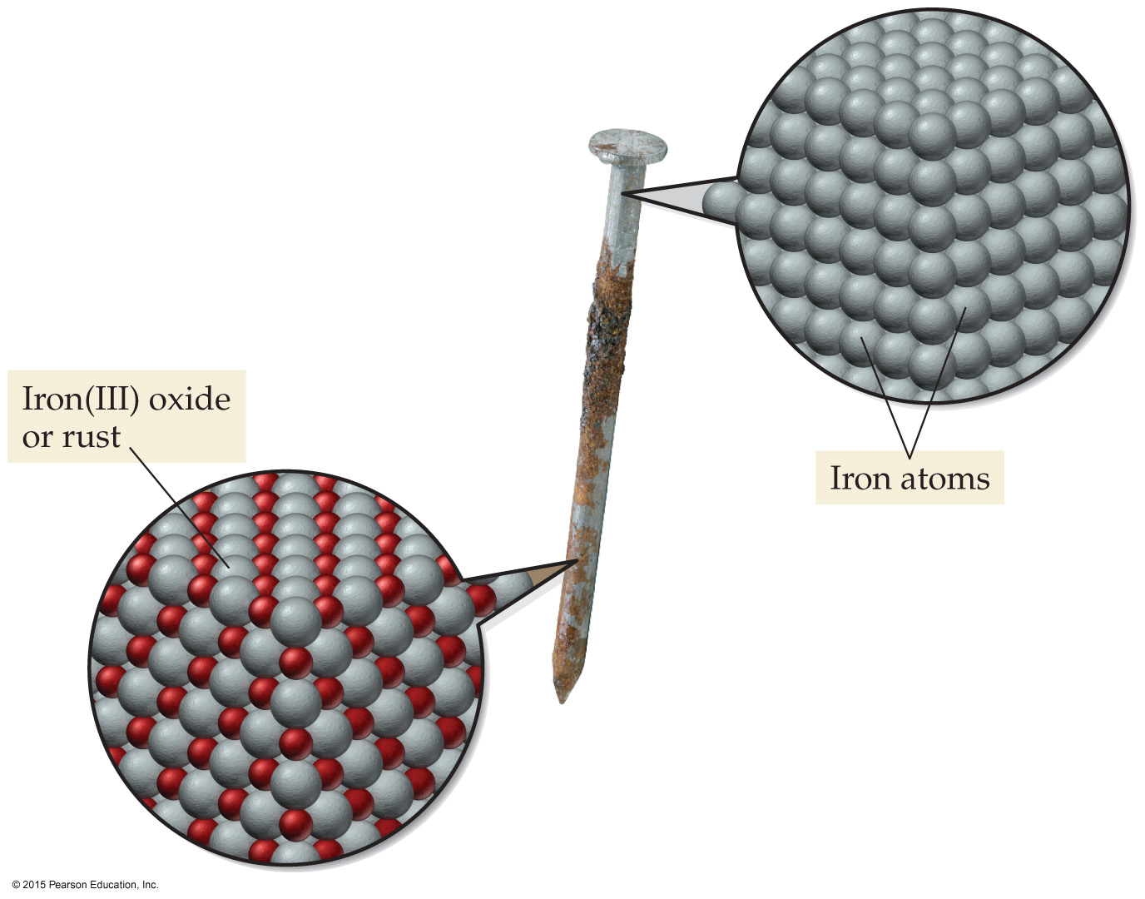
How many moles of oxygen are needed to produce 6 moles of Fe₂O₃ in the following equation? 4Fe + 3O₂ → 2Fe₂O₃
3
1
6
9
18
Notes:
Answer: D

Slide 70
How many moles of oxygen are needed to produce 6 moles of Fe₂O₃ in the following equation? 4Fe + 3O₂ → 2Fe₂O₃
3
1
6
9
18
Notes:
Answer: D

Slide 71
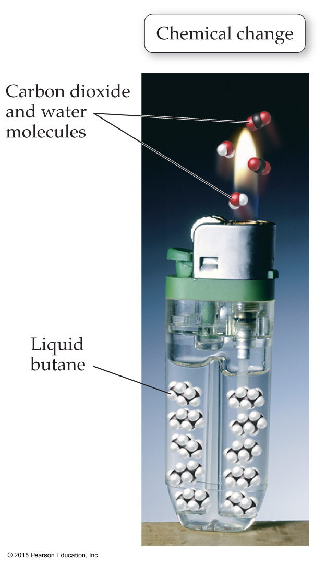
How many moles of gaseous oxygen are required for the complete combustion of 4.0 moles of butane (C₄H₁₀)?
4.0
8.0
13
26
52
Notes:
Answer: D

Slide 72
How many moles of gaseous oxygen are required for the complete combustion of 4.0 moles of butane (C₄H₁₀)?
4.0
8.0
13
26
52
Notes:
Answer: D

Slide 73
How many grams of oxygen are required to completely burn 5.90 g of C₃H₈ in the following unbalanced equation? C₃H₈(g) + O₂(g) → CO₂(g) + H₂O(g)
5.90 g
21.4 g
4.28 g
10.7 g
29.5 g
Notes:
Answer: B

Slide 74
How many grams of oxygen are required to completely burn 5.90 g of C₃H₈ in the following unbalanced equation? C₃H₈(g) + O₂(g) → CO₂(g) + H₂O(g)
5.90 g
21.4 g
4.28 g
10.7 g
29.5 g
Notes:
Answer: B

Slide 75
How many grams of aluminum sulfate are produced from 2.67 mol sulfuric acid in the following unbalanced equation? Al₂O₃(s) + H₂SO₄(aq) → Al₂(SO₄)₃(aq) + H₂O(l)
305 g
457 g
272 g
914 g
342 g
Notes:
Answer: A

Slide 76
How many grams of aluminum sulfate are produced from 2.67 mol sulfuric acid in the following unbalanced equation? Al₂O₃(s) + H₂SO₄(aq) → Al₂(SO₄)₃(aq) + H₂O(l)
305 g
457 g
272 g
914 g
342 g
Notes:
Answer: A

Slide 77
How many moles of phosphorus are required to produce 15.5 g P₄O₆ in the following equation? 4 P(s) + 3 O₂(g) → P₄O₆(s)?
34.9 mol
7.05 × 10^{–2} mol
4.00 mol
2.18 mol
0.282 mol
Notes:
Answer: E

Slide 78
How many moles of phosphorus are required to produce 15.5 g P₄O₆ in the following equation? 4 P(s) + 3 O₂(g) → P₄O₆(s)?
34.9 mol
7.05 × 10^{–2} mol
4.00 mol
2.18 mol
0.282 mol
Notes:
Answer: E

Slide 79
According to the following equation, how many moles of oxygen gas are produced from the decomposition of 3.0 mol of Al₂O₃? (Assume an 85% yield.) 2 Al₂O₃ → 4 Al + 3O₂
4.5 mol
3.8 mol
5.3 mol
3.0 mol
4.2 mol
Notes:
Answer: B

Slide 80
According to the following equation, how many moles of oxygen gas are produced from the decomposition of 3.0 mol of Al₂O₃? (Assume an 85% yield.) 2 Al₂O₃ → 4 Al + 3O₂
4.5 mol
3.8 mol
5.3 mol
3.0 mol
4.2 mol
Notes:
Answer: B

Slide 81
How many kg of methane (CH₄) are produced from 25.0 kg of hydrogen in the following catalytic methanation? 3 H₂ + CO → CH₄ + H₂O
115 kg
74.3 kg
134 kg
25.0 kg
66.3 kg
Notes:
Answer: E

Slide 82
How many kg of methane (CH₄) are produced from 25.0 kg of hydrogen in the following catalytic methanation? 3 H₂ + CO → CH₄ + H₂O
115 kg
74.3 kg
134 kg
25.0 kg
66.3 kg
Notes:
Answer: E

Slide 83
How many moles of water are produced from the combustion of 3.5 mol of hydrogen and 5.2 mol of oxygen?
7.0 mol
5.2 mol
3.5 mol
10. mol
1.8 mol
Notes:
Answer: C

Slide 84
How many moles of water are produced from the combustion of 3.5 mol of hydrogen and 5.2 mol of oxygen?
7.0 mol
5.2 mol
3.5 mol
10. mol
1.8 mol
Notes:
Answer: C

Slide 85
How many grams of NO are produced when 14.5 g of NH₃ are reacted with 12.2 g of O₂ according to the following equation? 4 NH₃ + 5 O₂ → 4 NO + 6 H₂O
0.305 g
25.5 g
18.3 g
9.15 g
0.851 g
Notes:
Answer: D

Slide 86
How many grams of NO are produced when 14.5 g of NH₃ are reacted with 12.2 g of O₂ according to the following equation? 4 NH₃ + 5 O₂ → 4 NO + 6 H₂O
0.305 g
25.5 g
18.3 g
9.15 g
0.851 g
Notes:
Answer: D

Slide 87
How many grams of the excess reagent are left over after the reaction of 4.36 g of Al and 8.50 g HCl in the following unbalanced equation? Al + HCl → AlCl₃ + H₂
2.26 g
4.14 g
2.3 g
21.5 g
10.4 g
Notes:
Answer: A

Slide 88
How many grams of the excess reagent are left over after the reaction of 4.36 g of Al and 8.50 g HCl in the following unbalanced equation? Al + HCl → AlCl₃ + H₂
2.26 g
4.14 g
2.3 g
21.5 g
10.4 g
Notes:
Answer: A

Slide 89
How many molecules of water are produced from the combustion of 2.56 mol of octane in the following equation? 2 C₈H₁₈ + 25 O₂ → 16 CO₂ + 18 H₂O?
1.08 × 10²⁵ molecules
2.77 × 10²⁵ molecules
2.56 × 10²⁵ molecules
1.39 × 10²⁵ molecules
6.02 × 10²³ molecules
Notes:
Answer: D

Slide 90
How many molecules of water are produced from the combustion of 2.56 mol of octane in the following equation? 2 C₈H₁₈ + 25 O₂ → 16 CO₂ + 18 H₂O?
1.08 × 10²⁵ molecules
2.77 × 10²⁵ molecules
2.56 × 10²⁵ molecules
1.39 × 10²⁵ molecules
6.02 × 10²³ molecules
Notes:
Answer: D

Slide 91
How many molecules of oxygen are produced from the decomposition of 8.75 g of hydrogen peroxide in the following equation? 2 H₂O₂ → 2 H₂ + O₂?
8.75 × 10²⁴ molecules
7.74 × 10²² molecules
1.55 × 10²² molecules
5.27 × 10²⁴ molecules
6.02 × 10²³ molecules
Notes:
Answer: B

Slide 92
How many molecules of oxygen are produced from the decomposition of 8.75 g of hydrogen peroxide in the following equation? 2 H₂O₂ → 2 H₂ + O₂?
8.75 × 10²⁴ molecules
7.74 × 10²² molecules
1.55 × 10²² molecules
5.27 × 10²⁴ molecules
6.02 × 10²³ molecules
Notes:
Answer: B

Slide 93
How many molecules of ammonia are produced from 7.54  10²⁵ molecules of hydrogen in the following equation? 3 H₂ + N₂ → 2 NH₃
2 molecules
7.54 × 10²⁵ molecules
5.03 × 10²⁵ molecules
1.51 × 10²⁶ molecules
6.02 × 10²³ molecules
Notes:
Answer: C

Slide 94
How many molecules of ammonia are produced from 7.54  10²⁵ molecules of hydrogen in the following equation? 3 H₂ + N₂ → 2 NH₃
2 molecules
7.54 × 10²⁵ molecules
5.03 × 10²⁵ molecules
1.51 × 10²⁶ molecules
6.02 × 10²³ molecules
Notes:
Answer: C

Slide 95
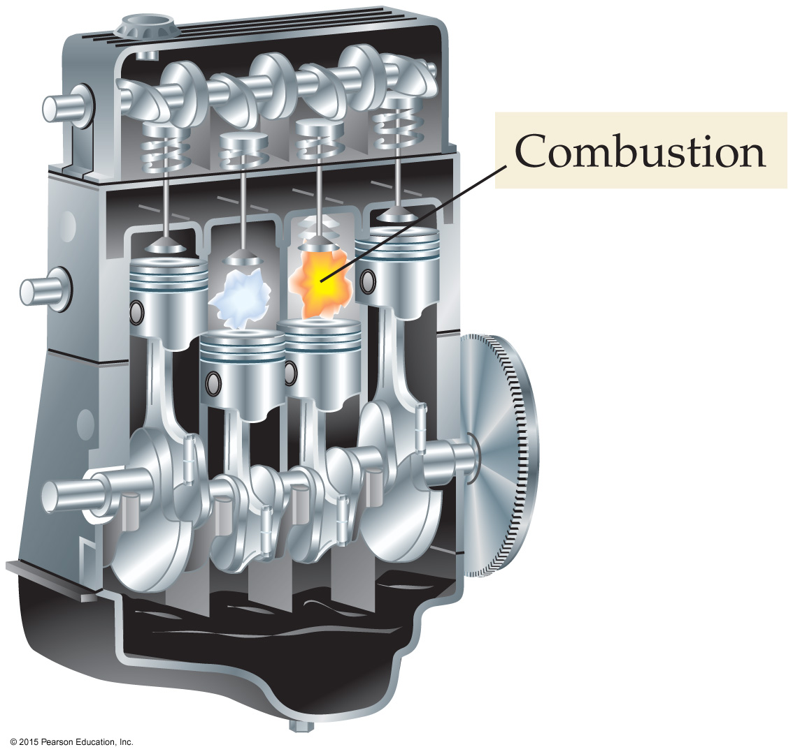
How many moles of CO₂ are produced from the combustion of 2.0 moles of C₈H₁₈ with 5.0 moles of O₂?
16 moles
8.0 moles
4.0 moles
3.0 moles
2.0 moles
Notes:
Answer: A

Slide 96
How many moles of CO₂ are produced from the combustion of 2.0 moles of C₈H₁₈ with 5.0 moles of O₂?
16 moles
8.0 moles
4.0 moles
3.0 moles
2.0 moles
Notes:
Answer: A

Slide 97
What is the theoretical yield of acetic acid when 22.5 g of methanol reacts with 32.0 g of carbon monoxide in the following equation? CH₃OH + CO → HC₂H₃O₂
24.2 g
32.0 g
42.2 g
68.6 g
84.4 g
Notes:
Answer: C

Slide 98
What is the theoretical yield of acetic acid when 22.5 g of methanol reacts with 32.0 g of carbon monoxide in the following equation? CH₃OH + CO → HC₂H₃O₂
24.2 g
32.0 g
42.2 g
68.6 g
84.4 g
Notes:
Answer: C

Slide 99
What is the theoretical yield of MgO from the combustion of 5.25 × 10²³ atoms of Mg and 4.69 × 10²³ molecules of O₂?
35.1 g
2.17 × 10²⁵ g
31.4 g
3.78 × 10²⁵ g
62.8 g
Notes:
Answer: A

Slide 100
What is the theoretical yield of MgO from the combustion of 5.25 × 10²³ atoms of Mg and 4.69 × 10²³ molecules of O₂?
35.1 g
2.17 × 10²⁵ g
31.4 g
3.78 × 10²⁵ g
62.8 g
Notes:
Answer: A

Slide 101
Which reactant is in excess when 35.0 g of hydrogen is reacted with 276 g of oxygen to form water?
H
O
O₂
H₂
H₂O
Notes:
Answer: D

Slide 102
Which reactant is in excess when 35.0 g of hydrogen is reacted with 276 g of oxygen to form water?
H
O
O₂
H₂
H₂O
Notes:
Answer: D

Slide 103
Which of the following statements is always true of the excess reactant in a chemical reaction?
It has the lowest mass.
Its coefficient in the balanced equation is the largest one.
It has the highest mass.
It doesn’t react completely.
None of the above
Notes:
Answer: D

Slide 104
Which of the following statements is always true of the excess reactant in a chemical reaction?
It has the lowest mass.
Its coefficient in the balanced equation is the largest one.
It has the highest mass.
It doesn’t react completely.
None of the above
Notes:
Answer: D

Slide 105
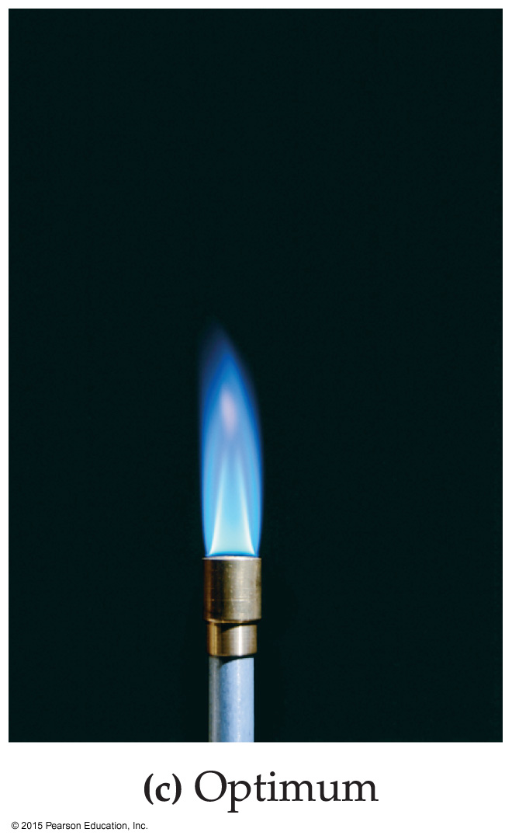
When methane (CH₄) is burned in oxygen, the theoretical yield is 28.9 g CO₂. A chemistry student performed the experiment and the yield was 26.4 g CO₂. What is the student’s percent yield?
100.%
91.3%
109%
85.2%
55.9%
Notes:
Answer: B

Slide 106
When methane (CH₄) is burned in oxygen, the theoretical yield is 28.9 g CO₂. A chemistry student performed the experiment and the yield was 26.4 g CO₂. What is the student’s percent yield?
100.%
91.3%
109%
85.2%
55.9%
Notes:
Answer: B

Slide 107
An experiment had a percent yield of 91.8% and the theoretical yield was calculated to be 28.2 g. How many grams were actually produced in the experiment?
25.9 g
2.50 g
92.0 g
28.5 g
30.7 g
Notes:
Answer: A

Slide 108
An experiment had a percent yield of 91.8% and the theoretical yield was calculated to be 28.2 g. How many grams were actually produced in the experiment?
25.9 g
2.50 g
92.0 g
28.5 g
30.7 g
Notes:
Answer: A

Slide 109
What is the limiting reactant for the reaction between 18.2 g of K and 8.38 g of water in the following unbalanced reaction? K + H₂O → KOH + H₂
K
H₂O
KOH
H₂
Both are used up at the same time.
Notes:
Answer: E

Slide 110
What is the limiting reactant for the reaction between 18.2 g of K and 8.38 g of water in the following unbalanced reaction? K + H₂O → KOH + H₂
K
H₂O
KOH
H₂
Both are used up at the same time.
Notes:
Answer: E

Slide 111
5.0 kg of hydrogen is reacted with 31 kg of oxygen. The experiment yields 28 kg of water. Calculate the percent yield of the reaction.
40.%
63%
80.%
90.%
161%
Notes:
Answer: C

Slide 112
5.0 kg of hydrogen is reacted with 31 kg of oxygen. The experiment yields 28 kg of water. Calculate the percent yield of the reaction.
40.%
63%
80.%
90.%
161%
Notes:
Answer: C

Slide 113
4.25 mol of Cl₂ are reacted with 1.49 mol NaOH according to the following reaction. If 12.5 g of NaClO₃ is produced, what is the percent yield? 3 Cl₂ + 6 NaOH → 5 NaCl + NaClO₃ + 3 H₂O
28.1%
47.3%
79.9%
82.8%
91.2%
Notes:
Answer: B

Slide 114
4.25 mol of Cl₂ are reacted with 1.49 mol NaOH according to the following reaction. If 12.5 g of NaClO₃ is produced, what is the percent yield? 3 Cl₂ + 6 NaOH → 5 NaCl + NaClO₃ + 3 H₂O
28.1%
47.3%
79.9%
82.8%
91.2%
Notes:
Answer: B

Slide 115
How much heat is associated with the reaction that produces 256.1 g of ammonia (NH₃)? N₂(g) + 3 H₂(g) → 2 NH₃(g) ΔH°_{rxn}= –92.45 kJ
92.45 kJ of heat is released
695.1 kJ of heat is released
184.9 kJ of heat is absorbed
184.9 kJ of heat is released
92 kJ of heat is released
Notes:
Answer: B

Slide 116
How much heat is associated with the reaction that produces 256.1 g of ammonia (NH₃)? N₂(g) + 3 H₂(g) → 2 NH₃(g) ΔH°_{rxn}= –92.45 kJ
92.45 kJ of heat is released
695.1 kJ of heat is released
184.9 kJ of heat is absorbed
184.9 kJ of heat is released
92 kJ of heat is released
Notes:
Answer: B

