Slide 1
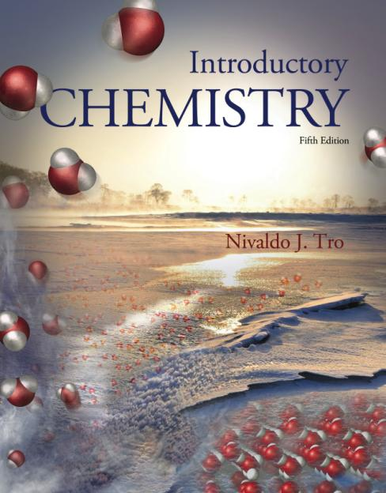
Introductory Chemistry Fifth Edition Nivaldo J. Tro Chapter 8 Quantities in Chemical Reactions
Dr. Sylvia Esjornson
Southwestern Oklahoma State University
Weatherford, OK

Slide 2
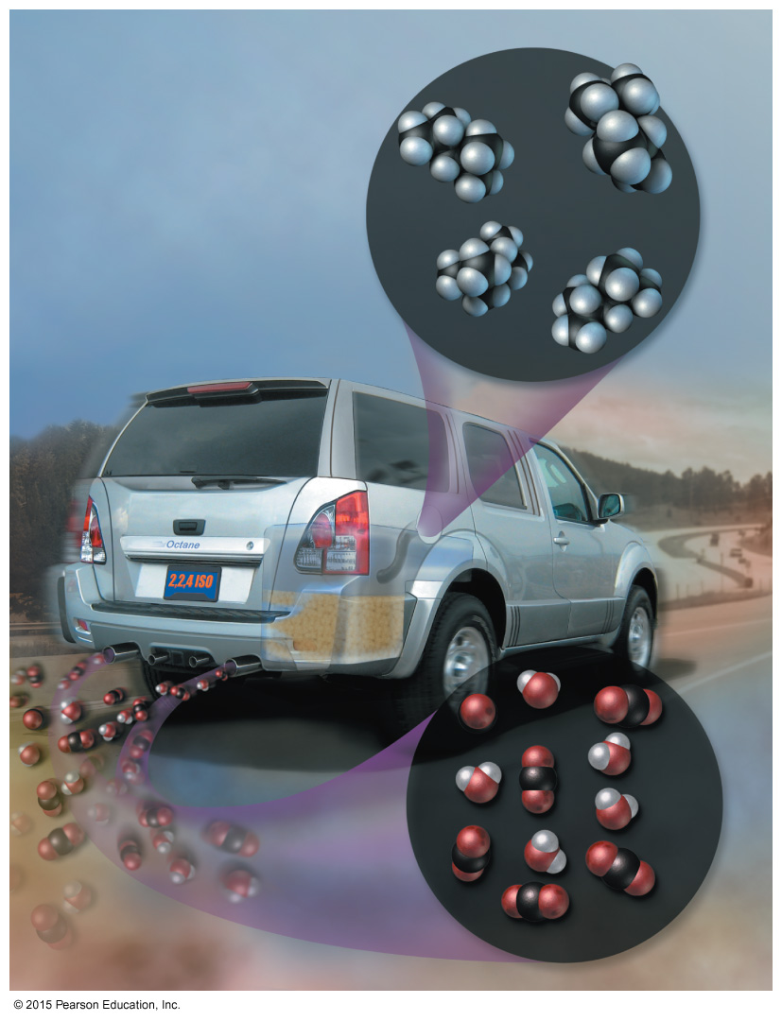
Global Warming: Too Much Carbon Dioxide
The combustion of fossil fuels such as octane (shown here) produces water and carbon dioxide as products.
Carbon dioxide is a greenhouse gas that is believed to be responsible for global warming.

Slide 3
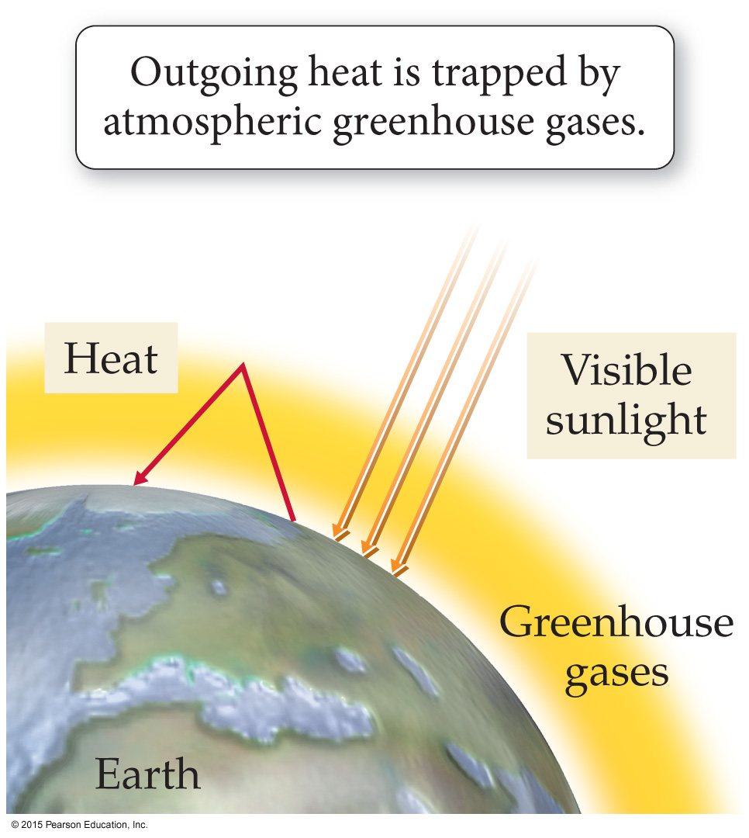
The Greenhouse Effect
Greenhouse gases act like glass in a greenhouse, allowing visible-light energy to enter the atmosphere but preventing heat energy from escaping.
Outgoing heat is trapped by greenhouse gases such as CO₂.

Slide 4
Combustion of Fossil Fuels Produces CO₂
Consider the combustion of octane (C₈H₁₈), a component of gasoline:
2 C₈H₁₈(l) + 25 O₂(g) → 16 CO₂(g) + 18 H₂O(g)
The balanced chemical equation shows that 16 mol of CO₂ are produced for every 2 mol of octane burned.

Slide 5
Combustion of Fossil Fuels Produces CO₂
Since we know the world’s annual fossil fuel consumption, we can estimate the world’s annual CO₂ production using the balanced chemical equation.
Calculation shows that the world’s annual CO₂ production—from fossil fuel combustion—matches the measured annual atmospheric CO₂ increase, implying that fossil fuel combustion is indeed responsible for increased atmospheric CO₂ levels.

Slide 6
Stoichiometry: Relationships between Ingredients
The numerical relationship between chemical quantities in a balanced chemical equation is called reaction stoichiometry.
We can predict the amounts of products that form in a chemical reaction based on the amounts of reactants.
We can predict how much of the reactants are necessary to form a given amount of product.
We can predict how much of one reactant is required to completely react with another reactant.

Slide 7
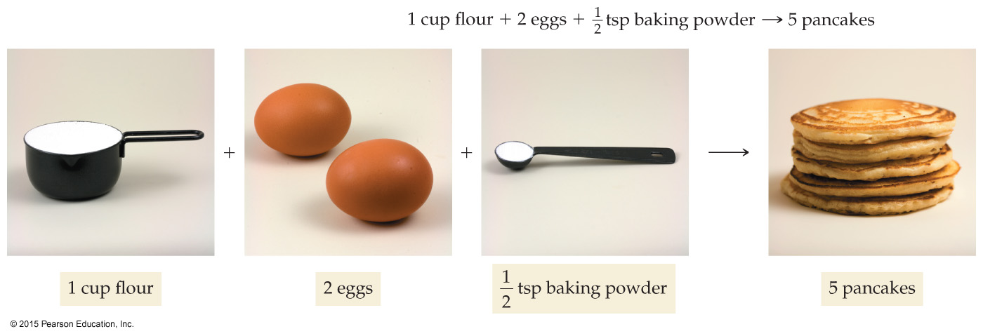
Making Pancakes: Relationships between Ingredients
A recipe gives numerical relationships between the ingredients and the number of pancakes.

Slide 8
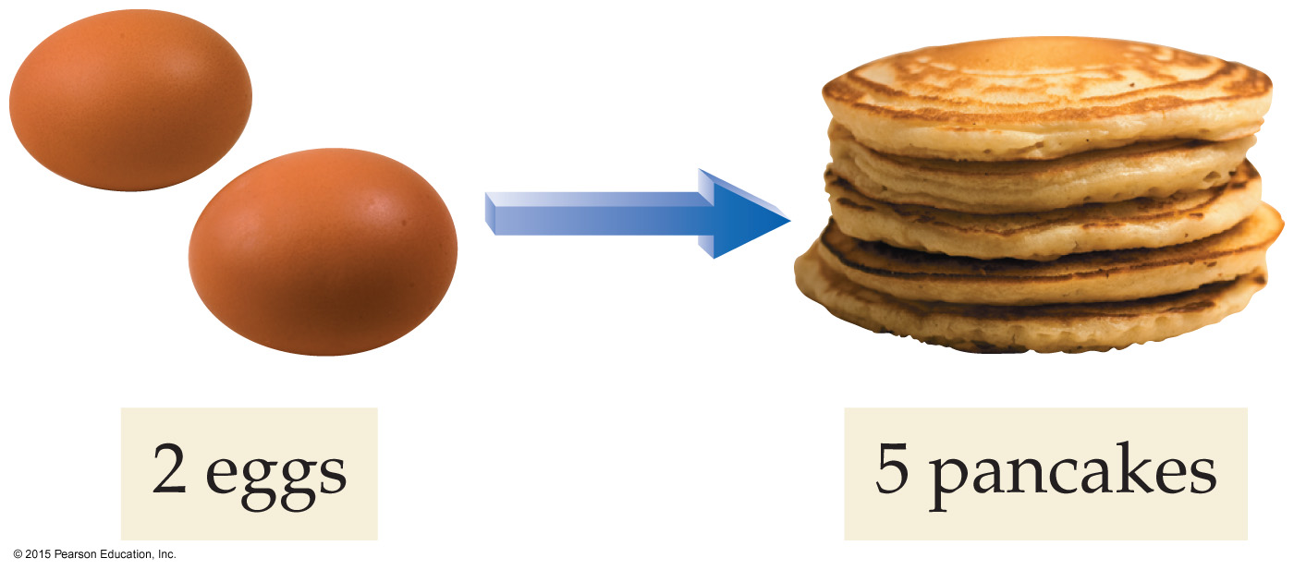
Making Pancakes: Relationships between Ingredients
The recipe shows the numerical relationships between the pancake ingredients.
If we have 2 eggs—and enough of everything else—we can make 5 pancakes.
We can write this relationship as a ratio.
2 eggs:5 pancakes

Slide 9
What if we have 8 eggs? Assuming that we have enough of everything else, how many pancakes can we make?

Slide 10
Making Molecules: Mole-to-Mole Conversions
In a balanced chemical equation, we have a “recipe” for how reactants combine to form products.
The following equation shows how hydrogen and nitrogen combine to form ammonia (NH₃).
3 H₂(g) + N₂(g) → 2 NH₃(g)

Slide 11
3 H₂(g) + N₂(g) → 2 NH₃(g)
The balanced equation shows that 3 H₂ molecules react with 1 N₂ molecule to form 2 NH₃ molecules.
We can express these relationships as ratios.
3 H₂ molecules : 1 N₂ molecule : 2 NH₃ molecules
Since we do not ordinarily deal with individual molecules, we can express the same ratios in moles.
3 mol H₂ : 1 mol N₂ : 2 mol NH₃

Slide 12
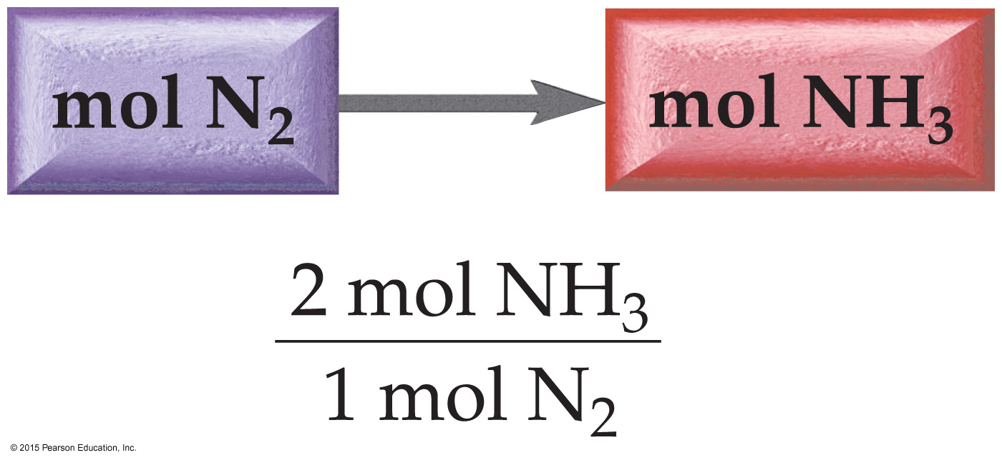
3 H₂(g) + N₂(g) → 2 NH₃(g)
If we have 3 mol of N₂, and more than enough H₂, how much NH₃ can we make?

Slide 13
Stoichiometry in Action: Not Enough Oxygen When Burning Octane
The balanced equation shows that 2 moles of octane require 25 moles of oxygen to burn completely:
2 C₈H₁₈(l) + 25 O₂(g) → 16 CO₂(g) + 18 H₂O(g)
In the case of octane, a shortage of O₂ causes side reactions that result in pollutants such as carbon monoxide (CO) and ozone.
The 1990 amendments to the Clean Air Act required oil companies to put additives in gasoline that increased its oxygen content.

Slide 14
Stoichiometry in Action: Controversy over Oxygenated Fuels
MTBE (methyl tertiary butyl ether, CH₃OC(CH₃)₃) was the additive of choice by the oil companies.
MTBE is a compound that does not biodegrade readily.
MTBE made its way into drinking water through gasoline spills at gas stations, from boat motors, and from leaking underground storage tanks.
Ethanol (C₂H₅OH), made from the fermentation of grains, is now used as a substitute for MTBE to increase oxygen content in motor fuel.
Ethanol was not used originally because it was more expensive.

Slide 15
Making Molecules: Mass-to-Mass Conversions
A chemical equation contains conversion factors between moles of reactants and moles of products.
We are often interested in relationships between mass of reactants and mass of products.
The general outline for this type of calculation is:

Slide 16
2 C₈H₁₈(l) + 25 O₂(g) → 16 CO₂(g) + 18 H₂O(g)
What mass of carbon dioxide is emitted by an automobile per 5.0 × 10² g pure octane used?
The balanced chemical equation gives us a relationship between moles of C₈H₁₈ and moles of CO₂.
Before using that relationship, we must convert from grams to moles.

Slide 17
2 C₈H₁₈(l) + 25 O₂(g) → 16 CO₂(g) + 18 H₂O(g)
SOLUTION MAP:

Slide 18
2 C₈H₁₈(l) + 25 O₂(g) → 16 CO₂(g) + 18 H₂O(g)
SOLUTION:

Slide 19
Limiting Reactant, Theoretical Yield, and Percent Yield
More pancakes
Recall the original equation:

Slide 20
Limiting Reactant, Theoretical Yield, and Percent Yield
Suppose we have 3 cups flour, 10 eggs, and 4 tsp baking powder.
How many pancakes can we make?
We have enough flour for 15 pancakes, enough eggs for 25 pancakes, and enough baking powder for 40 pancakes.

Slide 21
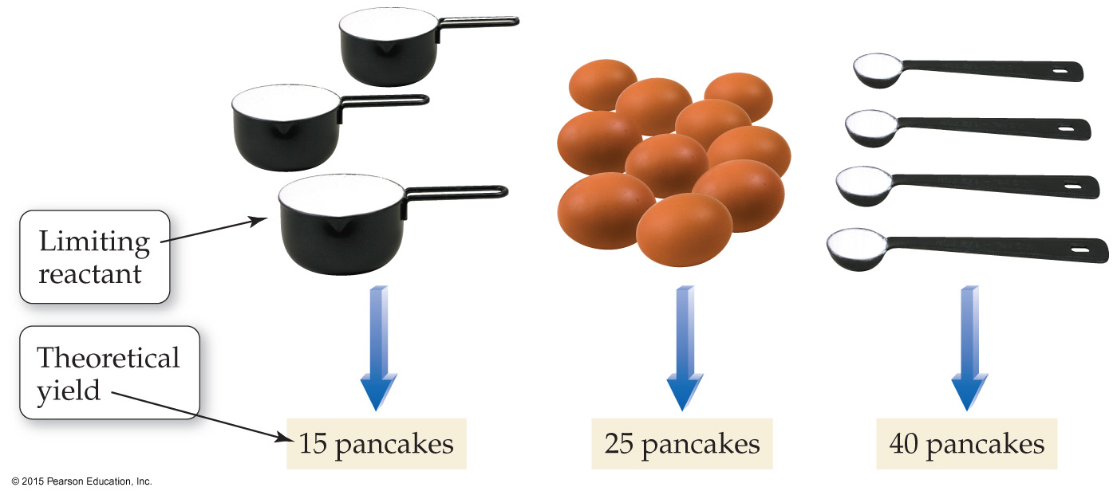
Limiting Reactant, Theoretical Yield, and Percent Yield
If this were a chemical reaction, the flour would be the limiting reactant and 15 pancakes would be the theoretical yield.

Slide 22
Limiting Reactant, Theoretical Yield, and Percent Yield
Suppose we cook our pancakes. We accidentally burn 3 of them and 1 falls on the floor.
So even though we had enough flour for 15 pancakes, we finished with only 11 pancakes.
If this were a chemical reaction, the 11 pancakes would be our actual yield, the amount of product actually produced by a chemical reaction.

Slide 23
Limiting Reactant, Theoretical Yield, and Percent Yield
Our percent yield, the percentage of the theoretical yield that was actually attained, is:
Since 4 of the pancakes were ruined,
we got only 73% of our theoretical yield.

Slide 24
Actual Yield and Percent Yield
The actual yield of a chemical reaction
must be determined experimentally and
depends on the reaction conditions.
The actual yield is almost always less than 100%.
Some of the product does not form.
Product is lost in the process of recovering it.

Slide 25
Limiting Reactant, Theoretical Yield, Actual Yield, and Percent Yield
To summarize:
• Limiting reactant (or limiting reagent)—the reactant that is completely consumed in a chemical reaction
• Theoretical yield—the amount of product that can be made in a chemical reaction based on the amount of limiting reactant
• Actual yield—the amount of product actually produced by a chemical reaction.
• Percent yield—(actual yield/theoretical yield)×100%

Slide 26
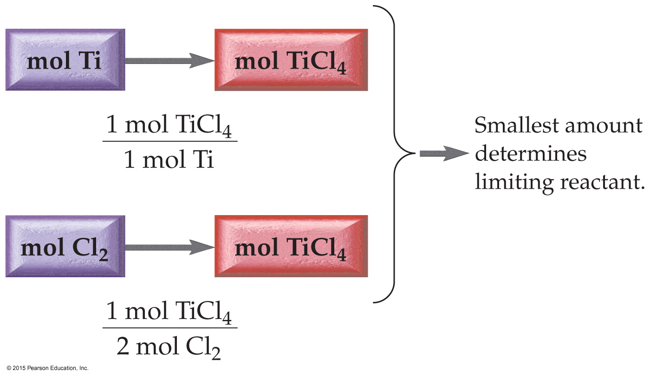
Limiting Reactant and Percent Yield: Mole to Mole
Example: Ti(s) + 2 Cl₂(g) → TiCl₄(s) Given (moles): 1.8 mol Ti and 3.2 mol Cl₂ Find: limiting reactant and theoretical yield SOLUTION MAP:

Slide 27
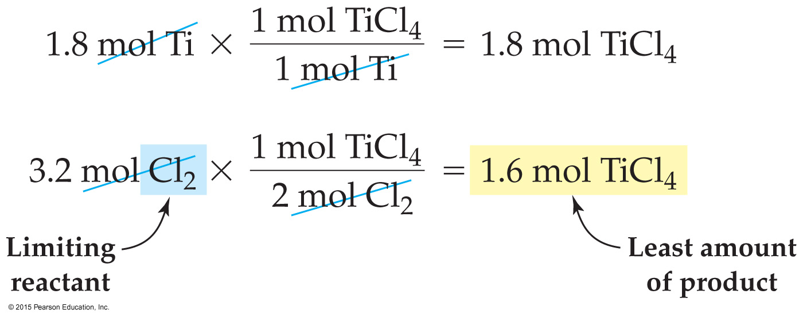
Limiting Reactant and Percent Yield: Mole to Mole
Example: Ti(s) + 2 Cl₂(g) → TiCl₄(s) Given (moles): 1.8 mol Ti and 3.2 mol Cl₂ Find: limiting reactant and theoretical yield SOLUTION:

Slide 28
Limiting Reactant, Theoretical Yield, Actual Yield, and Percent Yield
In many industrial applications, the more costly reactant or the reactant that is most difficult to remove from the product mixture is chosen to be the limiting reactant.
When working in the laboratory, we measure the amounts of reactants in grams.
To find limiting reactants and theoretical yields from initial masses, we must add two steps to our calculations.

Slide 29
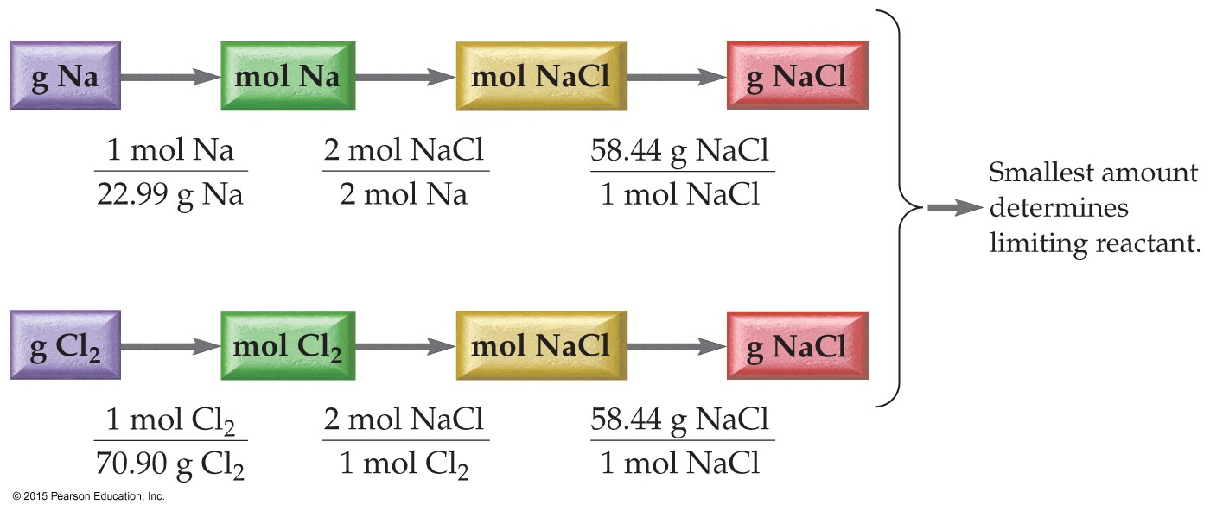
Limiting Reactant and Percent Yield: Gram to Gram
Example: Na(s) + Cl₂(g) → 2 NaCl(s) Given (grams): 53.2 g Na and 65.8 g Cl₂ Find: limiting reactant and theoretical yield SOLUTION MAP:

Slide 30
Limiting Reactant and Percent Yield: Gram to Gram
Example: Na(s) + Cl₂(g) → 2 NaCl(s) Given (grams): 53.2 g Na and 65.8 g Cl₂ Find: limiting reactant and theoretical yield SOLUTION:

Slide 31
Theoretical Yield and Percent Yield
Example: Na(s) + Cl₂(g) → 2 NaCl(s) Given (grams): actual yield 86.4 g NaCl Find: percent yield
The actual yield is usually less than the theoretical yield because at least a small amount of product is lost or does not form during a reaction.

Slide 32
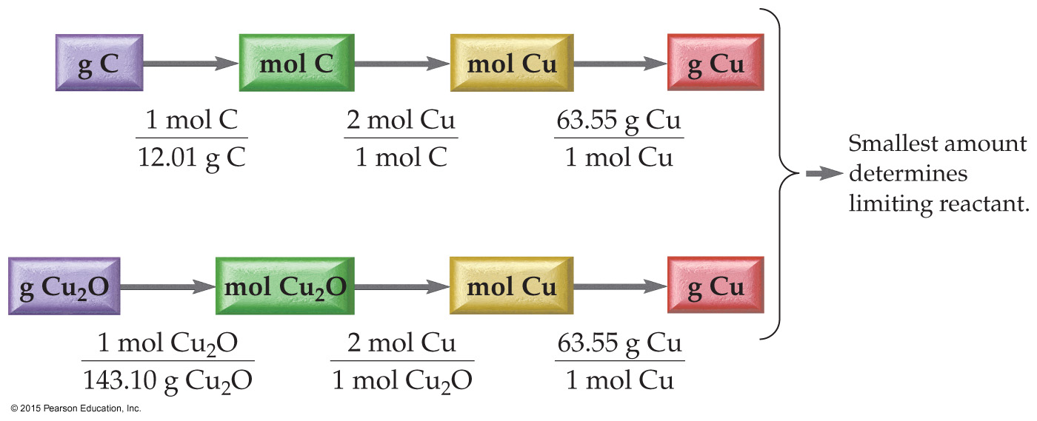
Limiting Reactant and Percent Yield: Gram to Gram
Example 8.6: Cu₂O(s) + C(s) → 2 Cu(s) + CO(g) Given (grams): 11.5 g Cu₂O and 114.5 g C Find: limiting reactant and theoretical yield SOLUTION MAP:

Slide 33
Relationships Used
The main conversion factors are the stoichiometric relationships between moles of each reactant and moles of copper.
The other conversion factors are the molar masses of copper(I) oxide, carbon, and copper.
1 mol Cu₂O : 2 mol Cu
1 mol C : 2 mol Cu
Molar mass Cu₂O = 143.10 g/mol
Molar mass C = 12.01 g/mol
Molar mass Cu = 63.55 g/mol

Slide 34
Limiting Reactant and Percent Yield: Gram to Gram
Example 8.6: Cu₂O(s) + C(s) → 2 Cu(s) + CO(g) Given (grams): 11.5 g Cu₂O and 114.5 g C Find: limiting reactant and theoretical yield SOLUTION:

Slide 35
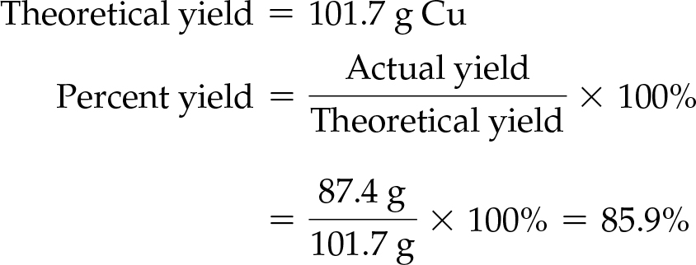
Actual Yield and Percent Yield
Example 8.6: Cu₂O(s) + C(s) → 2 Cu(s) + CO(g) Given (grams): actual yield 87.4 g Cu Find: percent yield SOLUTION:

Slide 36
Enthalpy: A Measure of the Heat Evolved or Absorbed in a Reaction
Chemical reactions can be exothermic (they emit thermal energy when they occur).
Chemical reactions can be endothermic (they absorb thermal energy when they occur).
The amount of thermal energy emitted or absorbed by a chemical reaction, under conditions of constant pressure (which are common for most everyday reactions), can be quantified with a function called enthalpy.

Slide 37
Enthalpy: A Measure of the Heat Evolved or Absorbed in a Reaction
We define the enthalpy of reaction, ΔH_{rxn}, as the amount of thermal energy (or heat) that flows when a reaction occurs at constant pressure.

Slide 38
Sign of ΔH_{rxn}
The sign of ΔH_{rxn} (positive or negative) depends on the direction in which thermal energy flows when the reaction occurs.
Energy flowing out of the chemical system is like a withdrawal and carries a negative sign.
Energy flowing into the system is like a deposit and carries a positive sign.

Slide 39
Exothermic and Endothermic Reactions
(a) In an exothermic reaction, energy is released into the surroundings. (b) In an endothermic reaction, energy is absorbed from the surroundings.

Slide 40
Sign of ΔH_{rxn}
When thermal energy flows out of the reaction and into the surroundings (as in an exothermic reaction), then ΔH_{rxn} is negative.
The enthalpy of reaction for the combustion of CH₄, the main component in natural gas, is as follows:
CH₄(g) + 2 O₂(g) → CO₂(g) + 2 H₂O(g) ΔH_{rxn} = –802.3 kJ
This reaction is exothermic and therefore has a negative enthalpy of reaction.
The magnitude of ΔH_{rxn} tells us that 802.3 kJ of heat are emitted when 1 mol CH₄ reacts with 2 mol O₂.

Slide 41
Sign of ΔH_{rxn}
When thermal energy flows into the reaction and out of the surroundings (as in an endothermic reaction), then ΔH_{rxn} is positive.
The enthalpy of reaction for the reaction between nitrogen and oxygen gas to form nitrogen monoxide is as follows:
N₂(g) + O₂(g) → 2 NO(g) ΔH_{rxn} = +182.6 kJ
This reaction is endothermic and therefore has a positive enthalpy of reaction.
The magnitude of ΔH_{rxn} tells us that 182.6 kJ of heat are absorbed from the surroundings when 1 mol N₂ reacts with 1 mol O₂.

Slide 42
Stoichiometry of ΔH_{rxn}
The amount of heat emitted or absorbed when a chemical reaction occurs depends on the amounts of reactants that actually react.
We usually specify ΔH_{rxn} in combination with the balanced chemical equation for the reaction.
The magnitude of ΔH_{rxn} is for the stoichiometric amounts of reactants and products for the reaction as written.

Slide 43
Stoichiometry of ΔH_{rxn}
For example, the balanced equation and ΔH_{rxn} for the combustion of propane (the fuel used in LP gas) is as follows:
C₃H₈(g) + 5 O₂(g) → 3 CO₂(g) + 4 H₂O(g) ΔH_{rxn} = −2044 kJ
When 1 mole of C₃H₈ reacts with 5 moles of O₂ to form 3 moles of CO₂ and 4 moles of H₂O, 2044 kJ of heat are emitted.
These ratios can be used to construct conversion factors between amounts of reactants or products and the quantity of heat exchanged.

Slide 44
Stoichiometry of ΔH_{rxn}
To find out how much heat is emitted upon the combustion of a certain mass in grams of propane C₃H₈, we can use the following solution map:

Slide 45
Example 8.7: Stoichiometry Involving ΔH_{rxn}
An LP gas tank in a home barbecue contains 11.8 × 10³ g of propane (C₃H₈).
Calculate the heat (in kJ) associated with the complete combustion of all of the propane in the tank.
C₃H₈(g) + 5 O₂(g) → 3 CO₂(g) + 4 H₂O(g) ΔH_{rxn} = −2044 kJ

Slide 46
Stoichiometry Involving ΔH_{rxn}
Example: Complete combustion of 11.8 × 10³ g of propane (C₃H₈) SOLUTION MAP:
RELATIONSHIPS USED:
1 mol C₃H₈ : –2044 kJ (from balanced equation)
Molar mass C₃H₈ = 44.11 g/mol

Slide 47
Stoichiometry Involving ΔH_{rxn}
Example: Complete combustion of 11.8 × 10³ g of propane (C₃H₈) SOLUTION:
Often in the homework, the absolute value of Q, |Q|, is requested and words are used to convey the sign of the heat absorbed or given off in the reaction.

Slide 48
Everyday Chemistry Bunsen Burners
Most Bunsen burners have a mechanism to adjust the amount of air (and therefore of oxygen) that is mixed with the methane.
If you light the burner with the air completely closed off, you get a yellow, smoky flame that is not very hot.
As you increase the amount of air going into the burner, the flame becomes bluer, less smoky, and hotter.
When you reach the optimum adjustment, the flame has a sharp, inner blue triangle, gives off no smoke, and is hot enough to melt glass easily.
Continuing to increase the air beyond this point causes the flame to become cooler again and may actually extinguish it.

Slide 49
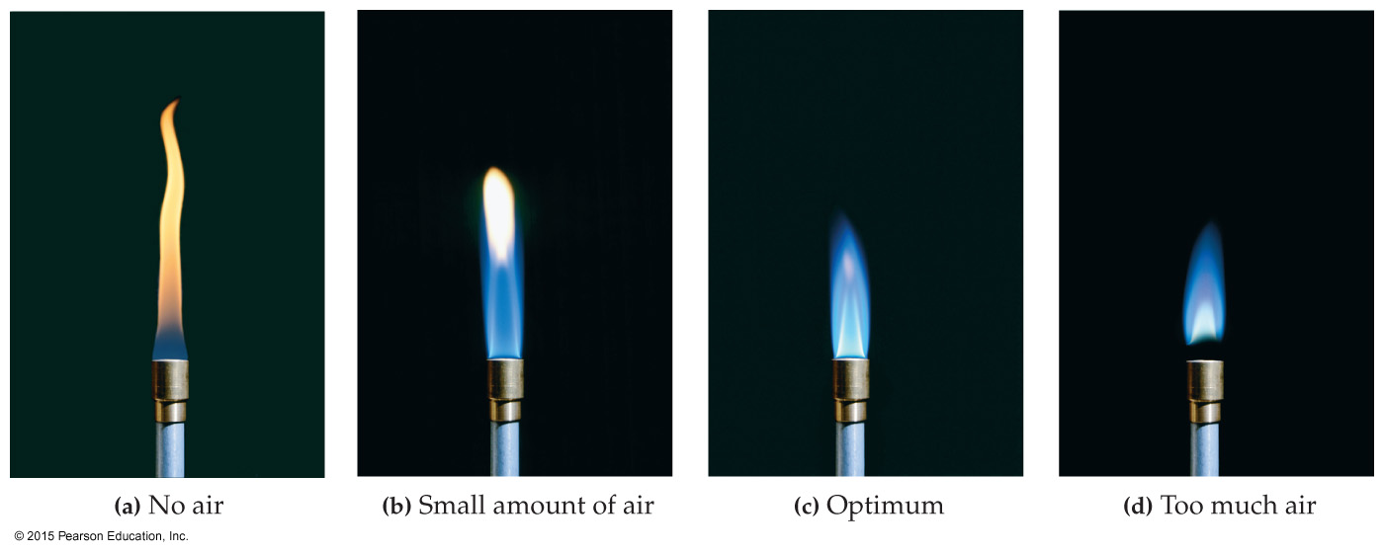
A Bunsen Burner at Various Stages of Air Intake Adjustment

Slide 50
Chapter 8 in Review
Stoichiometry: A balanced chemical equation gives quantitative relationships between the amounts of reactants and products. The quantitative relationship between reactants and products in a chemical reaction is called reaction stoichiometry.

Slide 51
Chapter 8 in Review
Limiting Reactant, Theoretical Yield, and Percent Yield:
The limiting reactant in a chemical reaction is the reactant that limits the amount of product that can be made.
The theoretical yield in a chemical reaction is the amount of product that can be made based on the amount of the limiting reactant.
The actual yield in a chemical reaction is the amount of product actually produced.
The percent yield in a chemical reaction is the actual yield divided by theoretical yield times 100%.

Slide 52
Chapter 8 in Review
Enthalpy of Reaction: The amount of heat released or absorbed by a chemical reaction under conditions of constant pressure is the enthalpy of reaction (ΔH_{rxn}).
The magnitude of ΔH_{rxn} is associated with the stoichiometric amounts of reactants and products for the reaction as written.

Slide 53
Chemical Skills Learning Objectives
LO: Recognize the numerical relationship between chemical quantities in a balanced chemical equation.
LO: Carry out mole-to-mole conversions between reactants and products based on the numerical relationship between chemical quantities in a balanced chemical equation.
LO: Carry out mass-to-mass conversions between reactants and products based on the numerical relationship between chemical quantities in a balanced chemical equation and molar masses.
LO: Calculate limiting reactant, theoretical yield, and percent yield for a given amount of reactants in a balanced chemical equation.
LO: Calculate the amount of thermal energy emitted or absorbed by a chemical reaction.

Slide 54
Highlight Problem EOC 8.101
Scientists have grown progressively more worried about the potential for global warming caused by increasing atmospheric carbon dioxide levels.
The world burns the fossil fuel equivalent of approximately 9.0 × 10¹² kg of petroleum per year.
Assume that all of this petroleum is in the form of octane (C₈H₁₈) and calculate how much CO₂ in kilograms is produced by world fossil fuel combustion per year.

Slide 55
Highlight Problem EOC 8.101
2 C₈H₁₈(l) + 25 O₂(g) → 16 CO₂(g) + 18 H₂O(g)
The balanced chemical equation shows that 16 mol of CO₂ are produced for every 2 mol of octane burned.
If the atmosphere currently contains approximately 3.0 × 10¹⁵ kg of CO_{2,} how long will it take for the world’s fossil fuel combustion to double the amount of atmospheric carbon dioxide?

Slide 56
Mass Percent
Note that the denominator is the mass of solution, not the mass of solvent.
In addition to parts per hundred (%), also in common use are parts per million (ppm), the number of grams of solute per 1 million g of solution, and parts per billion (ppb), the number of grams of solute per 1 billion g of solution.

Slide 57
Using Mass Percent in Calculations
We can use the mass percent of a solution as a conversion factor between mass of the solute and mass of the solution.
The key to using mass percent as a conversion factor is to write it as a fraction.

Slide 58
A Water Sample from the Bottom of Lake Nyos contains 8.5% carbon dioxide by mass. Determine how much carbon dioxide, in grams, is contained in 28.6 L of the water solution.
GIVEN:
8.5% CO₂ by mass
28.6 L solution
density = 1.03 g/mL
RECALL:
1000 mL = 1 L
FIND:
g CO₂

Slide 59
A Water Sample from the Bottom of Lake Nyos
SOLUTION MAP:
SOLUTION:

Slide 60
Specifying Solution Concentration: Molarity
Molarity (M) is defined as the number of moles of solute per liter of solution.
Note that molarity is moles of solute per liter of solution, not per liter of solvent.
To make a solution of a specified molarity, you usually put the solute into a flask and then add water to the desired volume of solution.

Slide 61
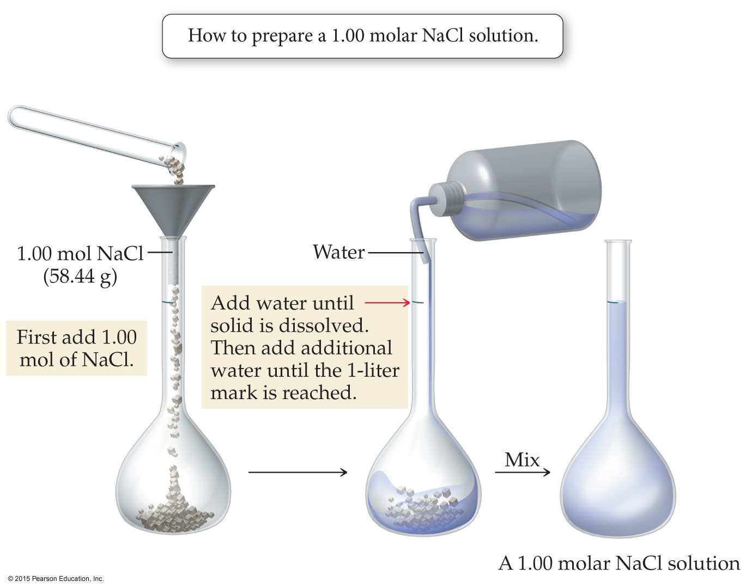
Making a Solution of Specific Molarity

Slide 62
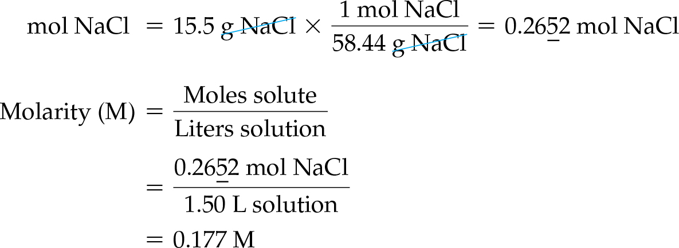
Calculate the molarity of a solution made by putting 15.5 g NaCl into a beaker and adding water to make 1.50 L of NaCl solution. GIVEN: 15.5 g NaCl, 1.50 L solution. FIND: molarity
SOLUTION:

Slide 63
Determine how many grams of sucrose (C₁₂H₂₂O₁₁) are contained in 1.72 L of 0.758 M sucrose solution.
SOLUTION MAP:
RELATIONSHIPS USED:

Slide 64
Determine how many grams of sucrose (C₁₂H₂₂O₁₁) are contained in 1.72 L of 0.758 M sucrose solution.
SOLUTION:

Slide 65
Ion Concentrations
The reported concentration of a solution containing a molecular compound usually reflects the concentration of the solute as it actually exists in solution.
A 1.0 M glucose (C₆H₁₂O₆) solution contains 1.0 mol of C₆H₁₂O₆ per liter of solution.
The reported concentration of a solution containing an ionic compound reflects the concentration of the solute before it is dissolved in solution.
A 1.0 M CaCl₂ solution contains 1.0 mol of Ca²⁺ per liter and 2.0 mol of Cl– per liter.
The concentration of the individual ions present in a solution containing an ionic compound can be approximated from the overall concentration.
These are approximations because when an ionic compound dissolves in solution, some of the cations and anions may pair up, so that the actual concentrations of the ions are lower than what you would expect if you assume complete dissociation occurred.

Slide 66
Determine the molar concentrations of Na⁺ and PO₄³⁻ in a 1.50 M Na₃PO₄ solution.
GIVEN: 1.50 M Na₃PO₄
FIND: molarity (M) Na⁺ and PO₄³⁻
SOLUTION:
Molarity of Na⁺ = 3(1.50 M) = 4.50 M
Molarity of PO₄³⁻ = 1.50 M

Slide 67
Solution Dilution
Solutions are often stored in concentrated forms called stock solutions.
Many lab procedures call for less concentrated solutions, so chemists must dilute the stock solution to the required concentration.
This is done by combining a certain amount of the stock solution with water.
To determine how much of the stock solution to use, use the dilution equation:
M₁V₁ = M₂V₂
where M₁ and V₁ are the molarity and volume of the initial concentrated solution and M₂ and V₂ are the molarity and volume of the final diluted solution.

Slide 68
M₁V₁ = M₂V₂
This equation works because the molarity multiplied by the volume gives the number of moles of solute (M × V = mol), which is the same in both solutions.
The equation M₁V₁ = M₂V₂ applies only to solution dilution, NOT to stoichiometry.

Slide 69
Laboratory Safety Note
When diluting acids, always add the concentrated acid to the water.
Never add water to concentrated acid solutions.

Slide 70
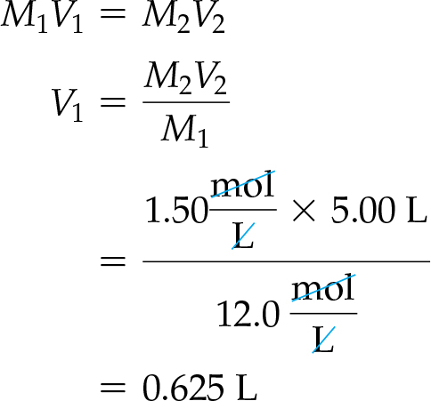
Prepare 5.00 L of a 1.50 M KCl solution from a 12.0 M stock solution.
GIVEN:
M₁ = 12.0 M
M₂ = 1.50 M
V₂ = 5.00 L
FIND:
V₁
SOLUTION:

Slide 71
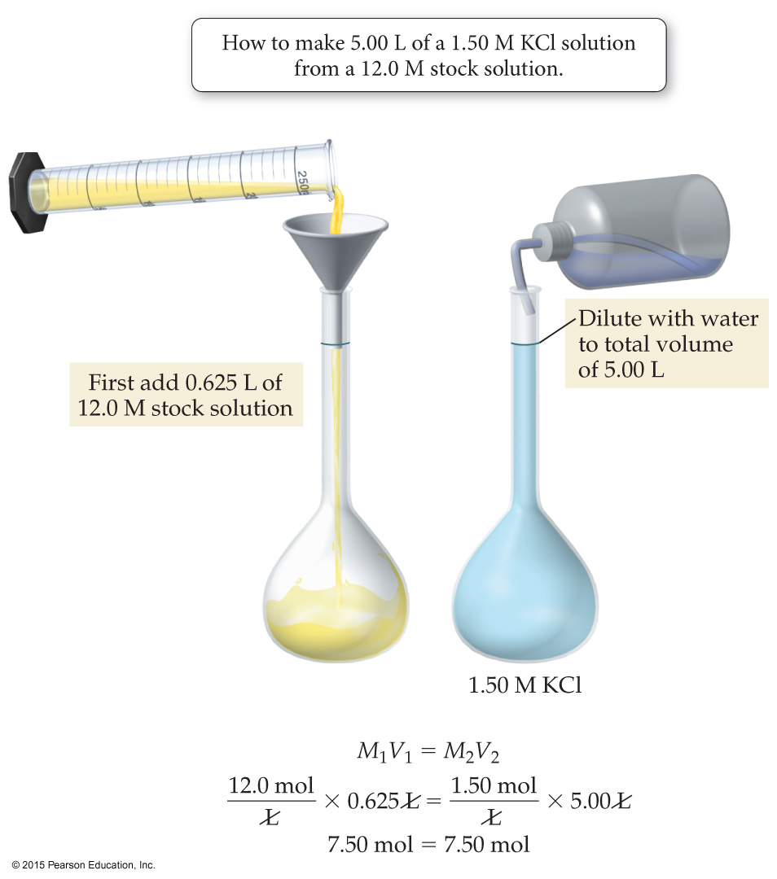
Prepare 5.00 L of a 1.50 M KCl solution from a 12.0 M stock solution.

Slide 72
Solution Stoichiometry
In reactions involving aqueous reactant and products, it is often convenient to specify the amount of reactants or products in terms of their volume and concentration.
We can use the volume and concentration to calculate the number of moles of reactants or products, and then use the stoichiometric coefficients to convert to other quantities in the reaction.

Slide 73
Solution Stoichiometry
The general solution map for these kinds of calculations is as follows:
where A and B are two different substances involved in the reaction, and the conversion factor between them comes from the stoichiometric coefficients in the balanced chemical equation.

Slide 74
H₂SO₄(aq) + 2 NaOH(aq) → Na₂SO₄(aq) + 2 H₂O(l)
How much 0.125 M NaOH solution do we need to completely neutralize 0.225 L of 0.175 M H₂SO₄ solution?
SOLUTION MAP:

Slide 75
H₂SO₄(aq) + 2 NaOH(aq) → Na₂SO₄(aq) + 2 H₂O(l)
How much 0.125 M NaOH solution do we need to completely neutralize 0.225 L of 0.175 M H₂SO₄ solution?
SOLUTION:

Slide 76
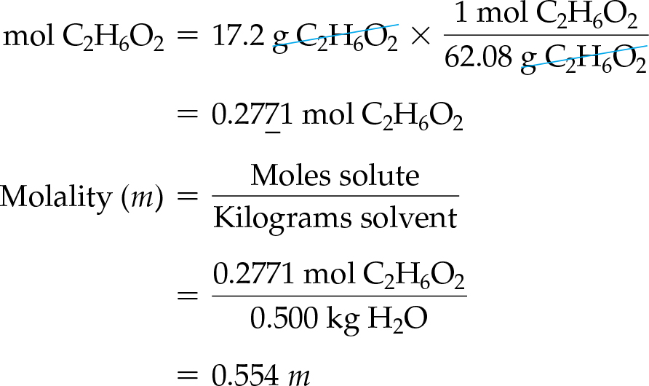
Calculate the molality of a solution containing 17.2 g of ethylene glycol C₂H₆O₂ dissolved in 0.500 kg of water.
GIVEN: 17.2 g C₂H₆O₂, 0.500 kg H₂O
FIND: molality (m)
SOLUTION:

